Slide 1
The National Clinical Programme for the Assessment and Management of Patients presenting to the Emergency Department following Self-Harm
Dr. Anne Jeffers.
28th Feb 2020

Slide 2
https://www.bing.com/videos/search?q=video+kevin+hines&view=detail&mid=94815772FF183F70934E94815772FF183F70934E&FORM=VIRE
HSE

Slide 3
The National Clinical Programme for the Assessment and Management of Patients presenting to the Emergency Department following Self-Harm
Dr. Anne Jeffers.
28th Feb 2020

Slide 4
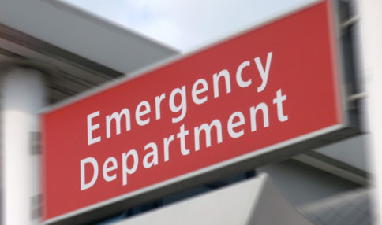
Agenda:
The National Clinical Programme
Sharing the Learning
Future Plans

Slide 5
Vision
To ensure this clinical programme is embedded into everyday clinical practice so that every individual who presents to the Emergency Department following an act of self harm, or with suicidal ideation, will receive a timely, expert assessment of their needs, and is connected to appropriate next care. That the individual and their family are valued and supported, by staff who themselves are valued and supported.

Slide 6
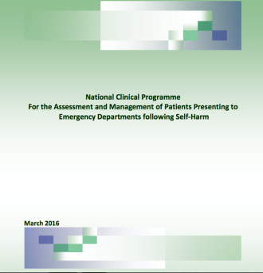
Why?
How?
Where?
www.hse.ie >clinical programmes>mental health> self-harm

Slide 7
Clinical Programme in the ED – to improve the engagement for people who self-harm
RESPONSE
COMPASSIONATE
VALIDATING
EMPATHIC
ASSESSMENT
EXPERT INTERVENTION
WRITTEN EMERGENCY
CARE PLAN
FAMILY/
ADULT
SUPPORT
BRIDGE TO NEXT CARE
HSE

Slide 8
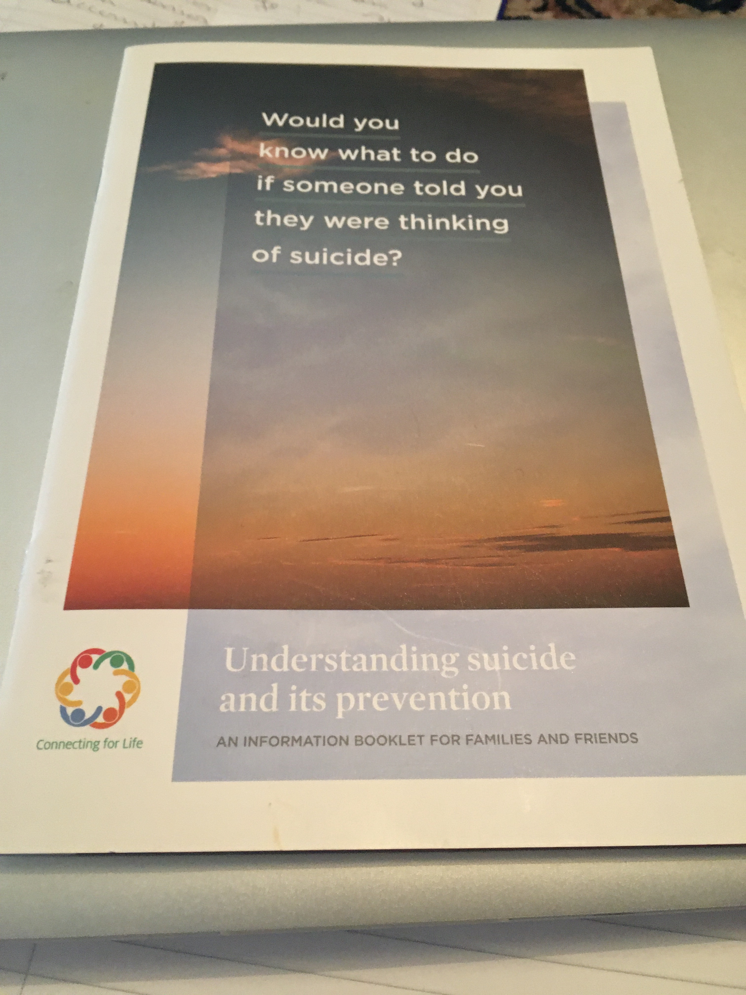
FAMILY
/ADULT SUPPORT
Every effort made to involve family or supportive adult.
History.
Discharge Planning.
Would you know what to do if someone told you they were thinking of suicide?
www.NOSP.ie

Slide 9
HSE

Slide 10
Vision
To ensure this clinical programme is embedded into everyday clinical practice so that every individual who presents to the Emergency Department following an act of self harm, or with suicidal ideation, will receive a timely, expert assessment of their needs, and is connected to appropriate next care. That the individual and their family are valued and supported, by staff who themselves are valued and supported.

Slide 11
Learning from the Clinical Programme
Heuristics and Bias in Risk Assessment
A role for Safety Planning
Need for improved communication

Slide 12
Heuristics and biases in risk assessment
Anchoring – The first piece of information acquired has a disproportionate large influence on judgments.
Confirmation bias – searching for and accepting information that confirms our beliefs , while ignoring information that refutes it.
Overconfidence bias – Superficial assessment of the patients suicide risk, based on incomplete information, intuition and biases.
Outcome bias – Tendency to assess preferred outcomes to be more likely than less preferred outcomes.
Diagnosis momentum – Tendency to assume the previous clinicians diagnosis is correct.
Vertical line failure - Thinking inside the box due to repetitive and routine working ways.
Risk Assessment Tools
Focus on diagnosis
Focus on Admission to Approved Centre

Slide 13
Heuristics and biases in risk assessment
Anchoring – The first piece of information acquired has a disproportionate large influence on judgments.
Confirmation bias – searching for and accepting information that confirms our beliefs , while ignoring information that refutes it.
Overconfidence bias – Superficial assessment of the patients suicide risk, based on incomplete information, intuition and biases.
Outcome bias – Tendency to assess preferred outcomes to be more likely than less preferred outcomes.
Diagnosis momentum – Tendency to assume the previous clinicians diagnosis is correct.
Vertical line failure - Thinking inside the box due to repetitive and routine working ways.
Hadlaczy – Suicide, an unnecessary death. 2016
Risk Assessment Tools
Focus on diagnosis
Focus on Admission to Approved Centre

Slide 14
Triage Risk Factors and Red Flag Warning Signs
Triage Risk Factors and Red Warning Signs:
www.connectingwithpeople.org
Demographic and Social
Personal Background
Clinical Factors in History
Mental State and suicidal thoughts
Perception of lack of support
Males
Stressful life event
Bereavement
Financial
worries
Loss of
relationship
Loss of job
Moving House.
Substance Misuse
Family or other history of suicide
Use of suicide promoting websites or social media
Access to lethal means
Previous history of self-harm or suicide attempt.
Mental illness esp. recent
Impulsivity or personality dis.
Long term medical condition/pain.
High degree of emotional pain and negative thoughts.
Sense of entrapment or shame
Suicidal thoughts getting worse/plan/
preparation
Psychotic phenomena
Validation - Empathy - Compassion
Notes:
These are risk factors with those in red particularly important.
Validaiton - Empathy - Compassion
14

Slide 15
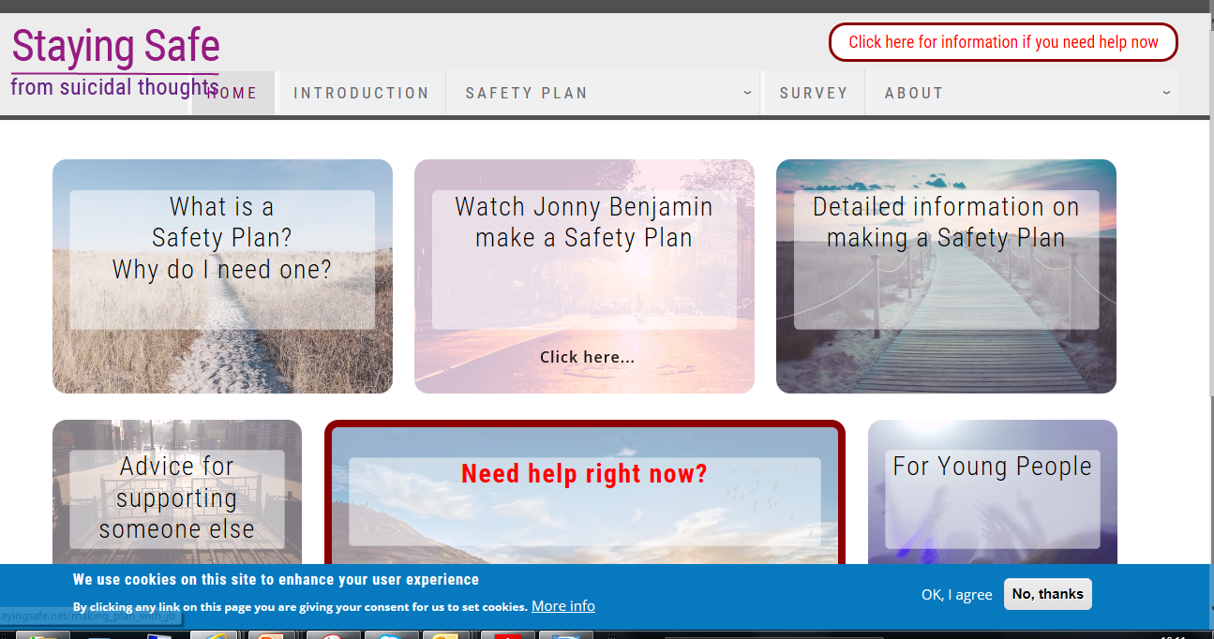
A Role for Safety Planning
www.suicidesafetyplan.com
Barbara Stanley and Gregory Brown.
www.stayingsafe.net
4MentalHealth
Warning signs
Internal coping
strategies.
3. People and social
settings that
provide distraction.
People whom I can
ask for help
Professionals or
agencies I can
contact during a crisis:
Making the
environment safe
Reasons for living :

Slide 16
Emergency Care Plan/ Safe Plan
1. Keeping Safe
Environment, internal coping strategies, supports.
2. Emergency Contacts
Numbers for phone lines and crisis text. Family or friend
support.
3. Next appointment
Addictions, Counselling; CMHT.
HSE

Slide 17
Need for improved Communication
Patient at the centre.
Links between the ED, CMHT, GP, Vol and statutory agencies. Flexible working.
Reviewing Model of Care – GP
- CMHT
- Children
Anne.jeffers1@hse.ie

Slide 18
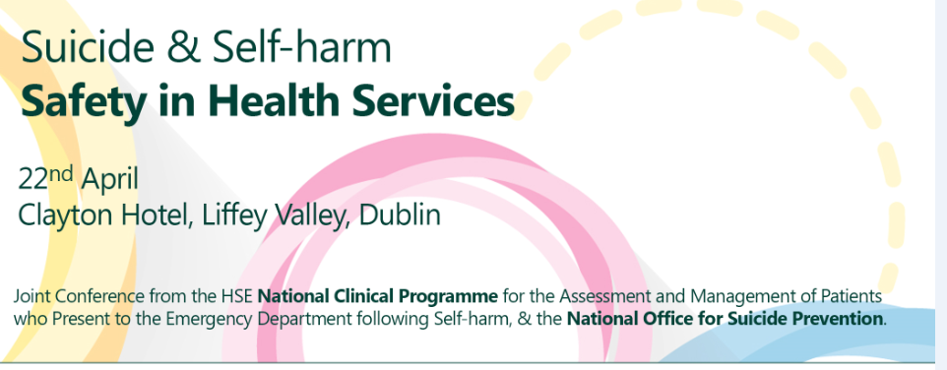
HSE
Notes:
18

Slide 19
What questions do you have?
HSE

