Slide 1
Self-Harm in High Risk Groups
February 2020
Multicentre Study of Self-harm
in England
Dr Caroline Clements
Email: MASH@manchester.ac.uk
Twitter @mashproject/@DrCClements
Website: Manchester.ac.uk/mash

Slide 2
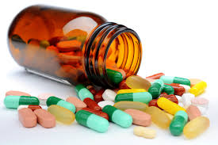
Self-Harm in High Risk Groups
February 2020
How do we define self-harm?
Multicentre Study of Self-harm
in England
Self-poisoning or self-injury irrespective of apparent motivation or medical seriousness

Slide 3
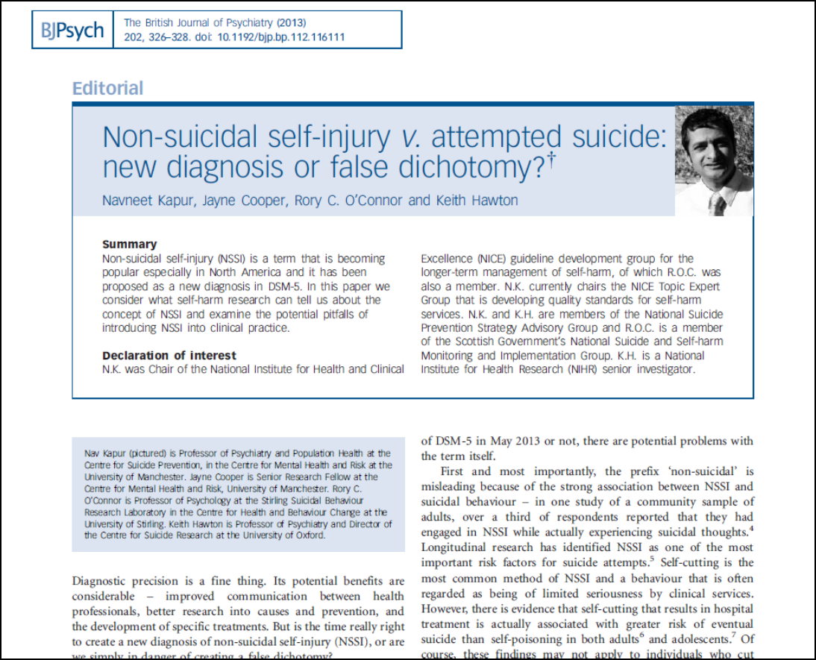
Self-Harm in High Risk Groups
February 2020
No clear cut off for what is/is not suicidal
Multicentre Study of Self-harm
in England
Reported intent changes over time
Risks are elevated after all self-harm, no matter the level of intent

Slide 4
Self-Harm in High Risk Groups
February 2020
Why is self-harm important?
National Suicide Prevention Strategy for England: Fourth revision
Multicentre Study of Self-harm
in England

Slide 5
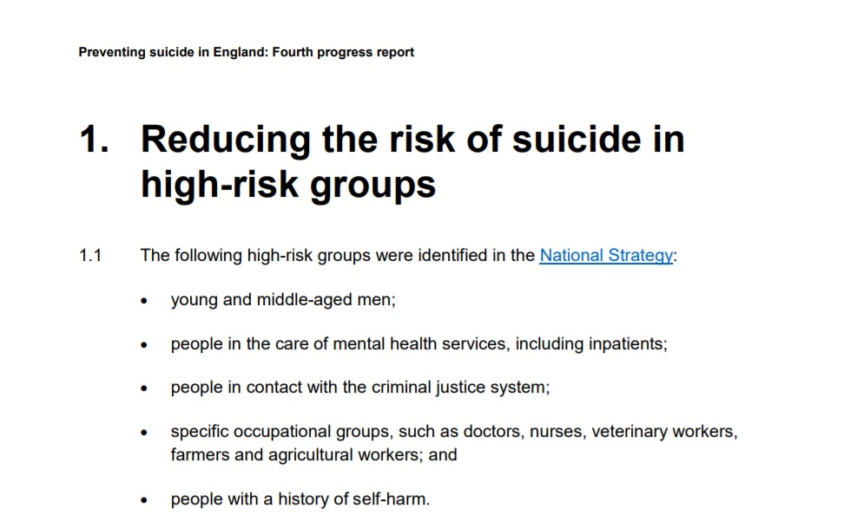
Self-Harm in High Risk Groups
February 2020
Why is self-harm important?
National Suicide Prevention Strategy for England: Fourth revision
Multicentre Study of Self-harm
in England
People with a history of self-harm

Slide 6
Self-Harm in High Risk Groups
February 2020
A brief introduction to the Manchester Self-Harm Project
Multicentre Study of Self-harm
in England
Established in 1997
At the Centre For Suicide Prevention
University of Manchester

Slide 7
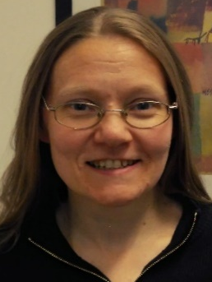
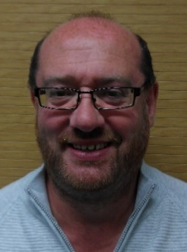
Self-Harm in High Risk Groups
February 2020
A brief introduction to the Manchester Self-Harm Project
The Team
Multicentre Study of Self-harm
in England
Professor Nav Kapur
Principal Investigator
Dr Caroline Clements
Project Manager
Harriet Bickley
Research Associate
Bushra Farooq
Research Assistant
Jackie Ward
Administrator
Iain Donaldson
Research Secretary

Slide 8
Self-Harm in High Risk Groups
February 2020
Why study hospital presenting self-harm?
Suicide
Multicentre Study of Self-harm
in England
Suicidal behaviours we know about
Hospital presentations for self-harm
Suicidal behaviours we do not know about
Self-Harm in the community

Slide 9
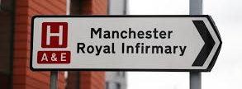
Why hospital presentations for self-harm?
Self-Harm in High Risk Groups
February 2020
Multicentre Study of Self-harm
in England
When people present to hospital following self-harm, it is a point of contact for services, and an opportunity for intervention to help address any underlying issues and reduce the risk of future self-harm

Slide 10
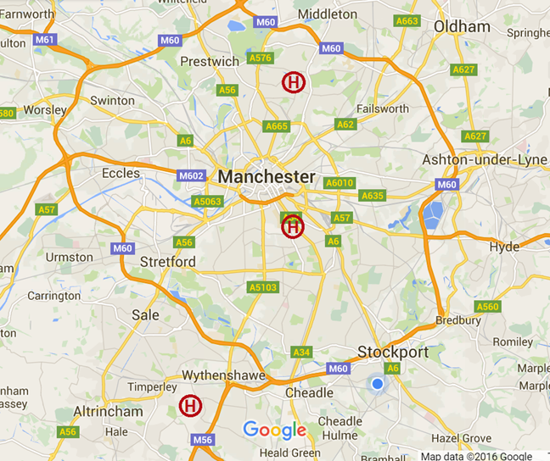
Data Collection
Self-Harm in High Risk Groups
February 2020
Greater Manchester Mental Health
NHS Foundation Trust
(The Mental Health Trust)
Multicentre Study of Self-harm
in England
North Manchester General Hospital
(North)
Manchester Royal Infirmary
(Central)
Wythenshawe Hospital
(South)

Slide 11
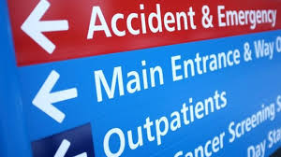
Self-Harm in High Risk Groups
February 2020
Multicentre Study of Self-harm
in England
The Multicentre Study is an ongoing collaboration between 3 high quality self-harm monitoring projects based in Oxford, Manchester and Derby.
Each site collects data on all self-harm presentations made to local emergency departments
By combining data we create a larger more representative database

Slide 12
Self-Harm in High Risk Groups
February 2020
What do we know about self-harm from Multicentre Study work
Multicentre Study of Self-harm
in England
A few questions about self-harm
Audience participation!!!

Slide 13
Self-Harm in High Risk Groups
February 2020
Question 1
Routinely collected hospital data underestimates the number of presentations for self-harm, but by how much?
Multicentre Study of Self-harm
in England
45-60%
25-40%

Slide 14
Self-Harm in High Risk Groups
February 2020
Question 1
Routinely collected hospital data underestimates the number of presentations for self-harm, but by how much?
Multicentre Study of Self-harm
in England
Routinely collected data can underestimate the number of presentations by up to 60%

Slide 15
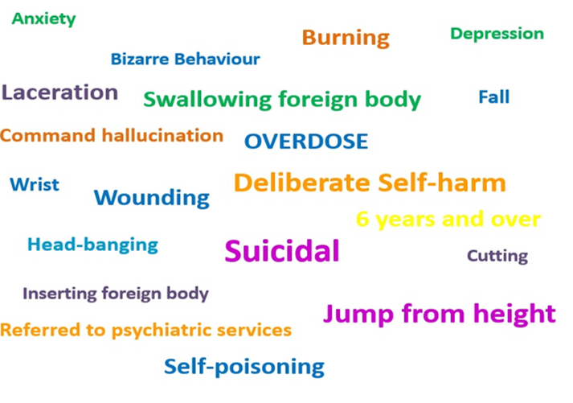
Self-Harm in High Risk Groups
February 2020
Question 1
Routinely collected hospital data underestimates the number of presentations for self-harm, but by how much?
Multicentre Study of Self-harm
in England
Routinely collected data can underestimate the number of presentations by up to 60%

Slide 16
Self-Harm in High Risk Groups
February 2020
Question 2
Do people who self-harm die younger than
people who do not self-harm?
Multicentre Study of Self-harm
in England
Yes
No

Slide 17
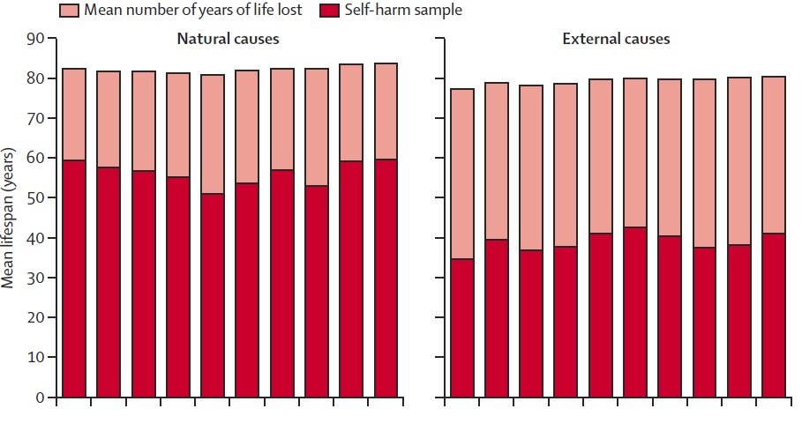
Self-Harm in High Risk Groups
February 2020
Question 2
Do people who self-harm die younger than
people who do not self-harm?
Multicentre Study of Self-harm
in England
Men
26 years
40 years
(Bergen et al, 2012)

Slide 18
Self-Harm in High Risk Groups
February 2020
Question 3
Are people who attend hospital following self-poisoning more likely to go on to die by suicide than people who present having self-injured?
Multicentre Study of Self-harm
in England
No
Yes
(Geulayov et al, 2019)

Slide 19
Self-Harm in High Risk Groups
February 2020
Question 3
Are people who attend hospital following self-poisoning more likely to go on to die by suicide than people who present having self-injured?
Multicentre Study of Self-harm
in England
Relative to hospital presentations after self-poisoning alone, suicide risk was higher after a hospital presentation for self-injury
Also presentations involving both self-injury and self-poisoning were associated with higher suicide risk
(Geulayov et al, 2019)

Slide 20
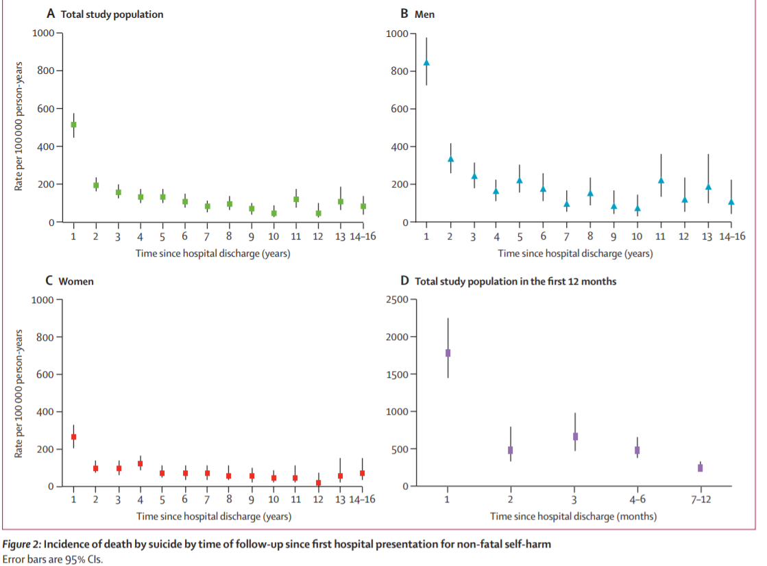
Self-Harm in High Risk Groups
February 2020
Question 3
Are people who attend hospital following self-poisoning more likely to go on to die by suicide than people who present having self-injured?
Multicentre Study of Self-harm
in England
Suicide risk was highest close to the self-harm presentation
Method switching was also common between self-harm and suicide (self-poisoning to hanging/asphyxiation)
(Geulayov et al, 2019)

Slide 21
Self-Harm in High Risk Groups
February 2020
Question 3
Are people who attend hospital following self-poisoning more likely to go on to die by suicide than people who present having self-injured?
Multicentre Study of Self-harm
in England
(Cooper et al, 2005)

Slide 22
Self-Harm in High Risk Groups
February 2020
Self-harm in high risk groups
People in midlife
2. Children and young people
Multicentre Study of Self-harm
in England

Slide 23
Self-Harm in High Risk Groups
February 2020
One more question...
What % of self-harm presentations are made by people in midlife (45-59 years)?
Multicentre Study of Self-harm
in England
15%
25%

Slide 24
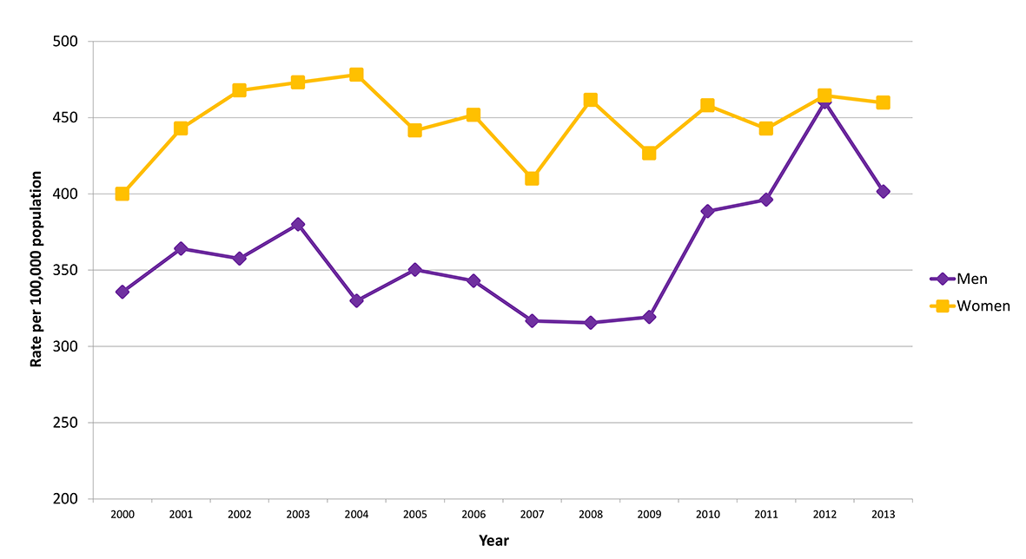
Self-Harm in High Risk Groups
February 2020
26% of all self-harm presentations are made by people in midlife
Multicentre Study of Self-harm
in England

Slide 25
Self-Harm in High Risk Groups
February 2020
Self-harm rate and suicide rate are associated in men in midlife – with and increase in both seen after 2008.
Multicentre Study of Self-harm
in England
(Clements et al, 2019)

Slide 26
Self-Harm in High Risk Groups
February 2020
Self-harm rate and suicide rate were not associated in women in midlife.
Multicentre Study of Self-harm
in England
(Clements et al, 2019)

Slide 27
Self-Harm in High Risk Groups
February 2020
Self-harm by people in midlife
Alcohol use, and socioeconomic factors were more common in men, while mental ill health was more common in women
Socioeconomic factors and indicators of poor mental health have become more common over time
25% repeated within 12 months
2.8% men and 1.2% women has died by suicide by the end of follow-up.
Multicentre Study of Self-harm
in England

Slide 28
Self-Harm in High Risk Groups
February 2020
Self-harm in high risk groups
People in midlife
2. Children and young people
Multicentre Study of Self-harm
in England

Slide 29
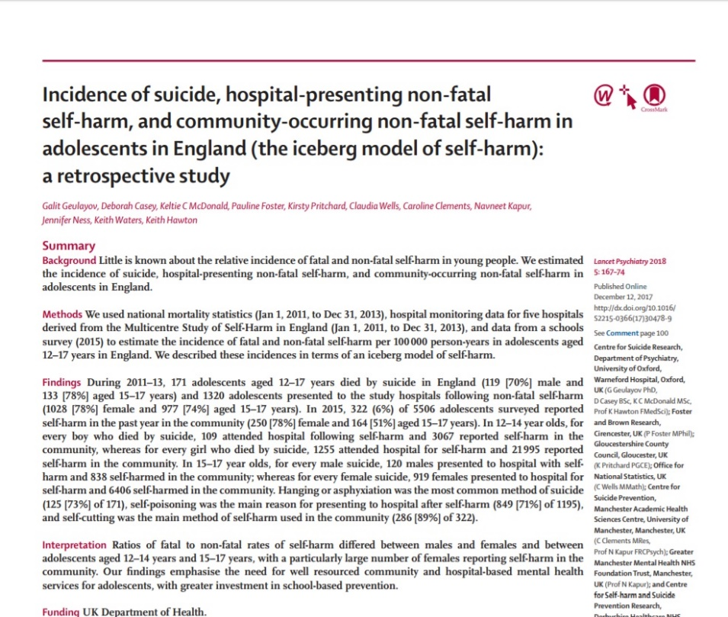
Self-Harm in High Risk Groups
February 2020
We looked at children who self-harm in the community, present to hospital for self-harm, and die by suicide
Multicentre Study of Self-harm
in England
(Geulayov, et al, 2017)

Slide 30
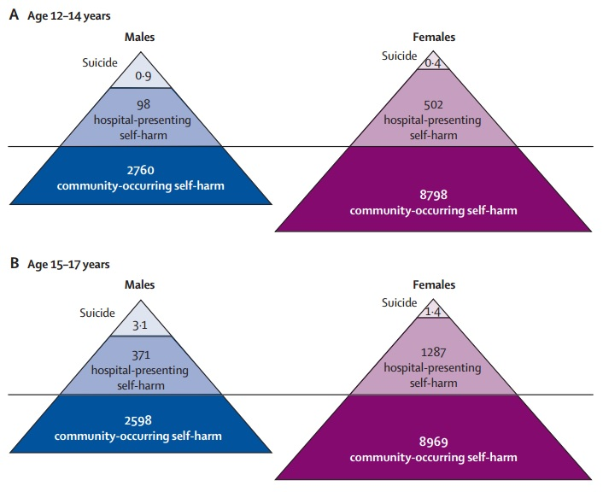
Self-Harm in High Risk Groups
February 2020
Iceberg models of suicide: hospital self-harm: community self-harm
Multicentre Study of Self-harm
in England
Boys 12-14 years
0.9: 98: 2760
Girls 12-14 years
0.4: 502: 8798
Boys 15-17 years
3.1: 371: 2598
Girls 15-17 years
1.4: 1287: 8969
(Geulayov, et al, 2017)

Slide 31
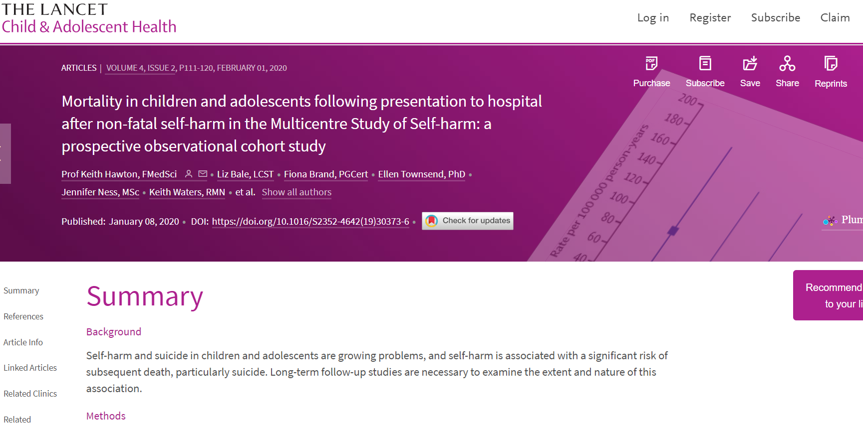
Self-Harm in High Risk Groups
February 2020
Mortality after self-harm in children and young people
Followed up n= 9173, 10 to 18 year-olds who had presented to the emergency departments of the study hospitals (2000-2013).
Deaths identified through the ONS via linkage with data from NHS Digital.
Multicentre Study of Self-harm
in England
(Hawton et al, 2020)

Slide 32
Self-Harm in High Risk Groups
February 2020
Mortality after self-harm in Children and Young people
Multicentre Study of Self-harm
in England
By the end of the follow-up period n=124 (1%) had died.
55 (44%) were due to suicide
27 (22%) were due to accidental causes
42 (34%) due to other causes.
Most suicide deaths involved self-injury (n=45, 82%).
There was often a method switch from self-harm to suicide, especially from self-poisoning to hanging or asphyxiation.
(Hawton et al, 2020)

Slide 33
Self-Harm in High Risk Groups
February 2020
Mortality after self-harm in children and young people
The incidence of suicide in the 12 months after self-harm was over 30 times the rate expected in the general population of 10-18 year-olds in England (SMR 31·0, 95% CI 18·2-30·9).
The majority of the suicides (n=42, 77%) occurred after age 18 years and the incidence rate remained similar over more than 10 years follow-up.
Increased suicide risk was associated with male gender, being an older teenager, use of self-injury (especially hanging/asphyxiation) for self-harm and repeating self-harm.
Accidental poisoning deaths involving substance misuse were especially frequent in males.
Multicentre Study of Self-harm
in England
(Hawton et al, 2020)

Slide 34
Self-Harm in High Risk Groups
February 2020
Multicentre Study of Self-harm
in England
Web: manchester.ac.uk/mash
Multicentre Study of Self-harm
in England
Web: psych.ox.ac.uk/research/csr/ahoj
Please get in touch:
caroline.v.clements@manchester.ac.uk

