Slide 1
A Practical Guide for Parents and Teachers Dealing with Self-Harm in Young People

Slide 2
Table of Contents
Background to Pieta
How can I help?
What is self-harm?
Who can self-harm?
Types and signs of self-harm
3 case studies
Self-harm: fact or fiction?

Slide 3
Background to Pieta
Notes:
Fwefojwien[fuwe 9gfourguw[ WQ
W

Slide 4
“
Pieta is an Intervention and Bereavement Counselling service delivering Warmth, Compassion and Hope to our clients and offering a commitment to build resilience in our young people and our communities.
Notes:
Accredited psychotherapist & counselling psychologist

Slide 5
Pieta
15 centres and 4 outreaches nationwide.
Free one-to-one Intervention and Bereavement counselling.
Suicide Bereavement Liaison Service.
24/7 Helpline Service.
Resilience Academy.
Notes:
The Resilience Academy aims to equip young people with the skills and knowledge to support themselves not just now but long into the future. Key Aims:
Enhancing protective factors
Developing coping skills
Increasing self efficacy
Increase awareness of supports
Encouraging help seeking behaviour
Reducing Stigma

Slide 6
59,529
Service users since 2006
8,048
Clients seen in centres in 2019
36%
Of all presenting conditions in 2019 related to self-harm

Slide 7
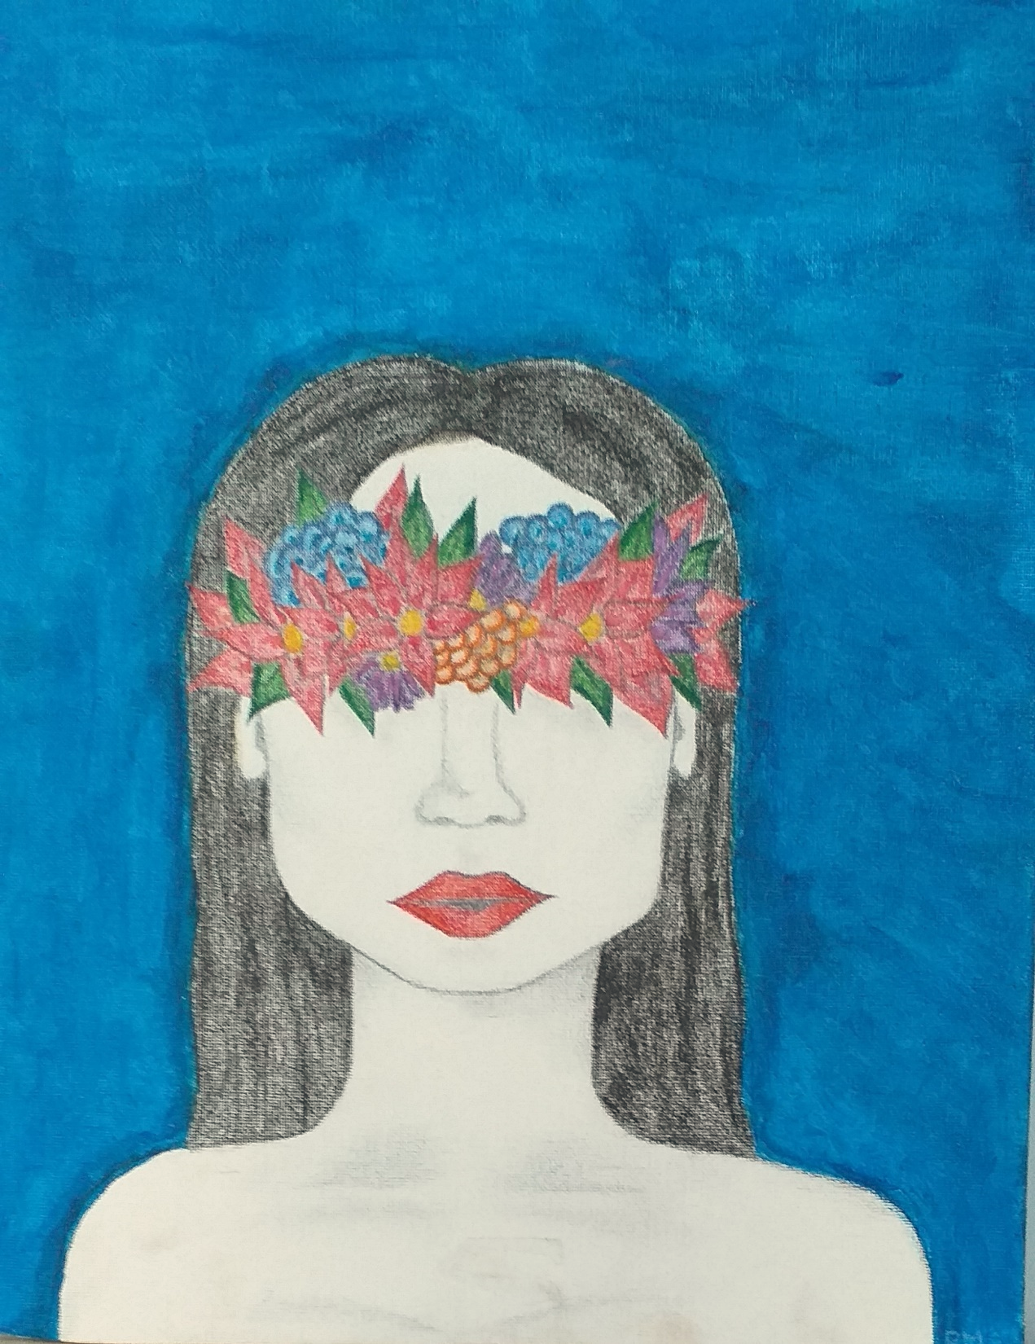
Bright Eyes
Artist: Rebecca, aged 16.
Starting treatment – felt as though she lived in darkness.
After treatment – felt more hopeful and life seemed brighter.

Slide 8
What is self-harm?

Slide 9
“
‘an act with non-fatal outcome in which
an individual deliberately initiates a non-habitual behaviour, that without intervention from others will cause self-harm, or deliberately ingests a substance in excess of the prescribed or generally recognised therapeutic dosage, and which
is aimed at realising changes that the person desires via the actual or expected physical consequences’ (Schmidtke et al, 2006)

Slide 10
What is self-harm?
Therapeutically:
Self harm is… attention needing
Notes:
As opposed to attention seeking

Slide 11
Self-Harm is a Coping Mechanism
Manage emotions
Express Emotions
Reduce tension
Feel in control
Distraction from emotional pain
Punish yourself
Escape
Make you feel alive
Notes:
Escape – from others, in an attempt to get out of relationships with others.

Slide 12
Who can self-harm?

Slide 13
Who Can Self-Harm?
ANYONE!
National Self-Harm Registry Ireland in 2018 recorded 12,588 presentations to hospital due to self-harm nationally, involving
9,785 individuals (NSRF, 2018).
These included people of all ages – though highest rates were among males aged 20-24 and females aged 15-19.
Notes:
It is likely that these numbers represent a portion of the numbers of people who have self harmed

Slide 14
Who Can Self-Harm?
However, there are risk factors that can make someone more likely to self-harm.
Life-events
Things that are happening with family, friends or work/ school.
Bereavement / Losses.
Environment
Homeless / direct provision
Certain groups of people
LGBT, Traveller Community, Young People, and people diagnosed with a mental health disorder.

Slide 15
Who Can Self-Harm?
Other Triggers
Difficulties at home,
Arguments or problems with friends,
School pressures,
Bullying,
Depression/ Anxiety,
Low self-esteem, and
Transitions and changes, such as changing schools.
Williams KA, et al. Why do adolescents engage in non-suicidal self-injury? American Nurse Today. 2018;13:37.

Slide 16
Who Can Self-Harm?
When a few of these issues come together people can quickly feel overwhelmed and everything becomes too much for one person to deal with.

Slide 17
Self-Harm Cycle
Emotional Suffering
Emotional Overload
Panic
Temporary Relief
Shame/ Grief
Self-Harm
Brain, K.L., Haines, J. & Williams, C.L. (1998). The psychophysiology of self-mutilation: Evidence of tension reduction. Archives of Suicide Research.4 (3),

Slide 18
Self Harm: Fact or Fiction?

Slide 19
Fact or Fiction?
‘Self-harm is attention-seeking’
Many who self-harm don’t talk to anyone about what they are going through, it can be hard to reach out and ask for help.
‘Only girls self-harm’
There is an assumption that girls are more likely than boys to self-harm, however it isn’t clear if this is true. Boys and girls may engage with different self-harming behaviours or different reasons for hurting themselves, this does not make it any less serious.

Slide 20
Fact or Fiction?
‘People who self-harm must enjoy it’
There is no evidence that people who self-harm feel pain differently than anyone else. For some, being depressed has left them numb and they want to feel anything to remind them they are alive, even if it hurts.

Slide 21
Fact or Fiction?
‘People who self-harm are suicidal’
For many self-harm is about trying to cope with difficult feelings and life circumstances. Some people have described it as a way of staying alive and surviving these difficulties. However, some people who self-harm can feel suicidal and might attempt to take their own life, this is why it must always be taken seriously.

Slide 22
Types and signs of self-harm

Slide 23
Types of Self-Harm
Biting
Branding
Chemical Burns
Cutting
Stabbing
Banging/ Bruising
Scratching
Picking
Bone breaking
Controlled/ Restricted eating
Hair pulling
Burning
Ingesting
Self-injury
Bulimia
Food Related
Self poisoning
Self-medicating
Over dosing
Over-eating
Anorexia
Self-Harm
Inhaling/ sniffing substances
Swallowing objects
Dangerous behaviours
Risk Taking Behaviour
Drugs and alcohol
Sexual behaviours
Breaking the law
Alcohol abuse
Drug abuse
Smoking
Acute (binge)
Chronic
Addition
Acute
Chronic
Addition

Slide 24
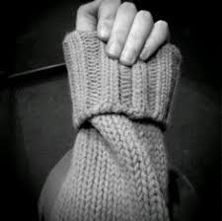
Self-Harm Signs
Unexplained cuts, bruises or cigarette burns - usually on the wrists, arms, thighs and chest,
Keeping themselves fully covered at all times, even in hot weather,
Pulling out their hair,
Alcohol or drugs misuse,
Self-loathing and expressing a wish to punish themselves,

Slide 25
Self-Harm Signs
Becoming very withdrawn and not speaking to others,
Changes in eating habits or being secretive about eating,
Unusual weight loss or weight gain,
Signs of low self-esteem, such as blaming themselves for any problems or thinking they're not good enough for something, and
Signs of depression, such as low mood, tearfulness or a lack of motivation or interest in anything.
Russell KR, et al. Identifying the signs of self-harm in students. NASN School Nurse. 2016;3:121.

Slide 26
How can I help?

Slide 27
How Can I Help?
Whether you walked in on your child self harming or the principal/school counsellor informed you, you need to plan the next step carefully,
Take a deep breath – this is tough, but it is better that you know about it,
Act Swiftly but calmly – Don’t ignore it, and
Don’t be afraid to be direct!
Seek support from a professional.
Notes:
Don’t react – RESPOND!! voluntary

Slide 28
How Can I Help?
QRP Approach:
Question
Persuade
Refer
QPR Institute: www.qprinstitute.com

Slide 29
3 Case Studies

Slide 30
Case Study 1
Mary is a mother of two teenage girls; Sophie aged 17 and Chloe aged 15.
Over the last two months Mary has noticed that Sophie has become very withdrawn from her friends and the rest of the family.
Mary has also noticed that Sophie is no longer wearing short sleeved tops – something she always used to wear.

Slide 31
Case Study 1
What shouldn’t Mary do?
Over-react or jump to conclusions.
Ask Chloe if she knows what’s going on with her sister?
Demand to see self-harm injuries.
What should Mary do?
Be transparent and let Sophie know that she has noticed a change.
Give time for Sophie to respond.

Slide 32
Case Study 1
It turned out that Sophie was self-harming…
What shouldn’t Mary do?
Judge her.
Blame her or give out to her about it.
Avoid the issue and assume that someone else will address it.
Go around removing all the sharp objects in the house.

Slide 33
Case Study 1
It turned out that Sophie was self-harming…
What should Mary do?
Be compassionate and caring.
Listen to her and hear her out.
Discern if her injuries need medical attention.
Encourage Sophie to seek support.
Re-assure her.

Slide 34
Case Study 2
Michael is a maths teacher in St. John’s secondary school.
Over the last few months he has noticed Sam, a fifth year student who struggles in class, overly blame himself for not doing well.
He also noticed, when he was handing back a test, that Sam had two cigarette burns on the back of his hand. One older looking wound and one newer one.

Slide 35
Case Study 2
What shouldn’t Michael do?
Over-react or jump to conclusions
Ignore it because its outside of his job’s remit.
Give out to Sam and ask him to cover his wounds up.
Demand that they stop self harming.

Slide 36
Case Study 2
What should Michael do?
Ask to Sam stay back after class and voice your concerns.
Follow your schools policy on self-harm disclosures – if your school does not have a policy consider developing one.
Let Sam know that you are informing the designated key member of staff about what you’ve seen.
Do not make promises you can’t keep such as keeping confidentiality.

Slide 37
Case Study 2
It turned out that Sam was self-harming…
What should the designated member of staff do?
Let Sam know you care and that you are going to help put supports in place for him and his family.
Contact the parents and invite them in for a conversation.
Ensure they have information about the services available for Sam.

Slide 38
Case Study 3
Tim’s parents discovered that he was self-harming one month ago when they saw a text to his friend Matt talking about what he was doing.
They asked him about it and he fortunately, after talking it through, they agreed to get professional support.

Slide 39
Case Study 3
What shouldn’t Tim’s parents do now?
Blame themselves for not seeing the signs sooner.
Blame Tim’s school for not being more pro-active.
Prevent Tim from seeing his friends because they are a bad influence.
Punish Tim for his actions.

Slide 40
Case Study 3
What should Tim’s parents do now?
Build strong lines of communication by:
Spending time together doing fun things.
Let Tim know that they are there for him if he should need them.
Be aware of the signs in case Time feels the urge to self-harm again.

Slide 41
Bright Eyes

Slide 42
Thank you for listening
You can contact Pieta at info@pieta.ie
Ending
Suicide.
Beginning
Hope.
Call free on
1800 247 247
Text HELP to
51444

