Slide 1
Attention Seeking or Relationship Seeking? “The use of therapeutic metaphor in the communication process of Deliberate Self harm”
Dr Colman Noctor
Self Harm Conference
SPMHS 2020

Slide 2
Why This topic?
When working in mental health there have been some presentations that have been more relatable than others.
However, Self-harm was one I always struggled with.
In order to overcome this issue I tried to explore the concept from an academic perspective….

Slide 3
What the books said….
Deliberate self-harm refers to an intentional act of causing physical injury to oneself without wanting to die. Deliberate self-harm behaviours most commonly include cutting, scratching or intentional drug overdose
These acts are often gratifying and cause minor to moderate harm. Some individuals self-harm on a regular basis, while others do it only a few times. Although deliberate self-harm is done without lethal intent, it can lead to fatality

Slide 4
Several theories have been proposed to create an understanding of self-harm?
These theories are not mutually exclusive, and each describe DSH as involving intense emotional states.
Most patients have reported feeling extremely tense, anxious, angry or fearful prior to the act of SH.
SH behaviour is positively reinforced through feelings of relief, satisfaction and decreased tension.
Some adolescents may also engage in deliberate self-harm behaviours in the process of social learning among their peers, out of curiosity or in order to ‘fit in’.

Slide 5
There was a lot on the ‘what’ of DSH but a lot less on the ‘why’

Slide 6
The science of subjectivity
There are many reasons, explanations and origins of behaviour
To suggest that any one understanding is universally applicable is perhaps unhelpful
My illustration today is but one possible dynamic that may help us to create an understanding of one of the possible meanings of DSH

Slide 7
Evolution of presentation
Similar to Eating Disorders the presentation of DSH has become more visible
There are wider explanations of how the concepts of sharing, public and private are undergoing changes…
I am going to contentiously suggest that the presentation of DSH has become more open than previously observed and therefore its perceived meaning may be different too?

Slide 8
Working with young people
Language can be a challenge
Universal sense of being misunderstood
A pre-conceived idea that clinicians want to stop them Self-Harming
A sense of feeling lost
Often they are poor communicators
They benefit from narratives that are relatable

Slide 9
Understanding your world through the lens that you see the world

Slide 10
The Rasher Metaphor

Slide 11
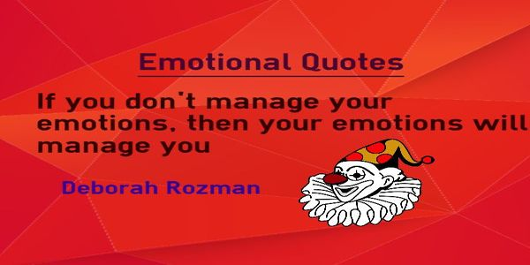
Understanding the emotional dynamic of DSH through Metaphor

Slide 12
Using metaphor TO PROMOTE UNDERSTANDING

Slide 13
Therapeutic Use of metaphor
Metaphor employs familiar symbols which are designed to provoke change in entrenched patterns of understanding
Metaphor is a linguistic, rhetorical device which functions as fundamental organizing property of our conceptual system.
There are numerous familiar examples of metaphorical concepts e.g., ‘time is money’, and happy is ‘up’ and sad is ‘down’ ‘heart of gold’ ‘apple of my eye’
These show not only how pervasive these metaphorical concepts are, but how they come to structure “how we perceive, how we think, and what we do”
Suggesting metaphors can be determinative.

Slide 14
Engaging Young people in therapy
Begin first by acknowledging the function of the symptom
Discuss the dynamics of DSH in the context of a relationship
Explore the possibility that EVERY BEHAVIOUR HAS MEANING and DSH is best conceptualised as a solution to a problem as opposed to the origin of the problem.

Slide 15
The ‘sign post’ metaphor
DSH Is not the problem, it is a solution to a problem
The behaviour signals/ directs attention to the emotional origin
Perhaps as professionals we tend to gather around the signpost without considering where it is pointing…..

Slide 16
Psychological origins which require DSH to cope
Self hatred
Social isolation
Depression
Low self worth
Visibility
Communication issues
Relationship issues
DSH preoccupation

Slide 17
Childhood Origins of DSH as communicating Pain and Emotion
DSH in Childhood, what does it communicate?
Holding your breath
Banging your head
Biting yourself
I wish I was dead!!/
You’ll be sorry when I am dead!!!
Funeral Fantasy

Slide 18
When language Fails behavior takes over

Slide 19
Refusal as a communication of need

Slide 20
Symptom as a vehicle for emotional Communication

Slide 21
An effective flare
DSH is universally recognised in CAMHS as a red flag
Usually catalysing an urgent response in support systems
Makes others ‘sit up and listen’
Making it a very effective flare when one is lost in a metaphorical forest where no one seems to hear you scream.

Slide 22
Attention seeking
or relationship seeking?

Slide 23
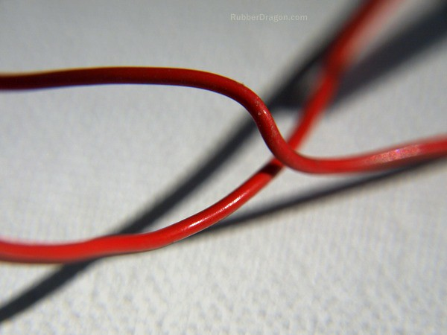
How these wires cross
The concept of visibility

Slide 24
The difference between wanting to be seen and wanting to be dead

Slide 25
Creating a model of understanding of DSH as a mode of control, coping & communication

Slide 26
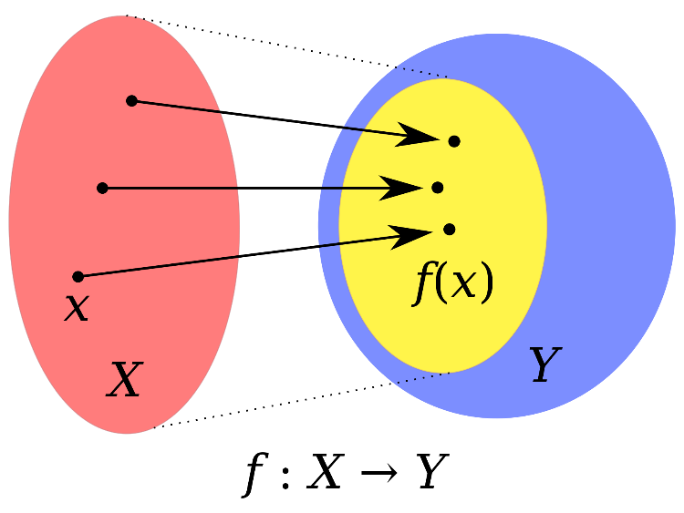
The function of DSH
First try to see DSH as a form of Communication.
Then see it as a behaviour that can be used to exercise Control, (numb, soothe, distract)
Seeing DSH as a means of Coping with or to gain a sense of personal power over feelings.
In the short term this behaviour serves a coping purpose as it may relieve stress or anxiety.

Slide 27
Unfortunately in the long term DSH ends up creating more problems for the individual. Recovery begins with exploring the purpose or function of this behaviour

Slide 28
Without awareness of the function, engagement is very difficult and understanding is impossible

Slide 29
Understanding the function of the symptom via the Pie Chart of control

Slide 30
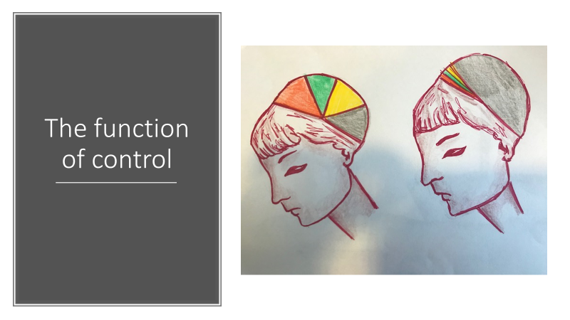

Slide 31
How does preoccupation serve a function?
The things that used to preoccupy you, don’t anymore
They use to occupy 90% of your thinking/ feeling time, now they have been reduced to 10%
The old preoccupations were overwhelming and out of one’s control where as the new preoccupation is solely within your control
You now have a break glass option for if things get too bad.

Slide 32
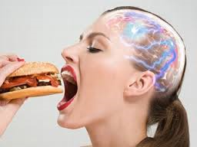
Addictive Comparisons
Like any addiction, DSH can be considered a psychoactive activity
This can make it compulsive and obsessive in nature
Therefore there is a potential to develop a dangerous relationship with this activity

Slide 33
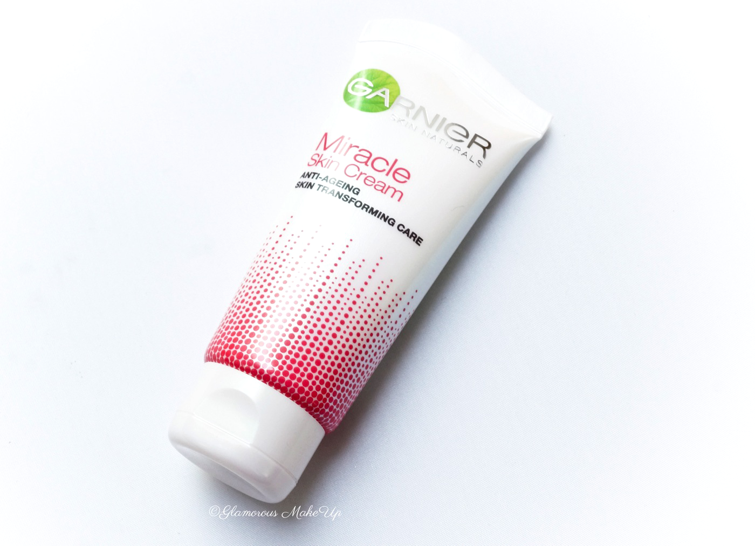
DSH as A miracle cream

Slide 34
It’s not about bleeding, its about feeling
Individuals who engage in DSH tend to suffer from low self worth, depression, anxiety
A common thread is their sensitive nature and an inability to respond appropriately to feelings.
Therefore DSH is best understood as a combination of emotional factors, interacting with biological and physiological variables in a vulnerable individual.
This is at it’s core and therefore has multiple strands of emotional emphasis

Slide 35
The 3 dimensions of the human subject
Ucs
Emotion
Cognition
Behaviour

Slide 36
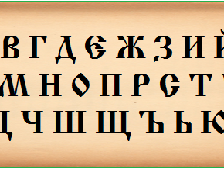
DSH as a language

Slide 38
Resistance to change

Slide 39
Helping someone who self harms
Create a supportive environment
Creative open relationships
Create an alliance that encourages them to take control at a level they can manage
Help them to see the reality of the relationship

Slide 40
Getting inside the mind of DSH
A typical presentation
The narrative frenemy
The return of the self
The construction of a new self
Give them a voice other than DSH
Make the SH redundant
Return to the rest of their lives

Slide 41
inside out

Slide 42
The over arching belief system
If you treat a symptom, sometimes you win and sometimes you lose….. But if you treat a person, you win every time…..
(Adams 1994)

Slide 43
“Much is made of metaphor, and little has been learned” With respect to the use of metaphoric tasks in psychotherapy I say “Little is made of metaphor, and much has been learned.”

Slide 44
Thank You
Colman Noctor
@colnoc77

Slide 45
References
All of the young people over the last 22 years who have helped me understand this complex dynamic.
‘The answer that is often simple, it’s just not easy’
(1995-2020)

