Slide 1
Sensory Strategies In The Classroom
Veronica O’ Connell, Senior Occupational Therapist

Slide 2
Objectives
Have a basic knowledge of sensory modulation and the senses
Understand the “Just Right” State
Have an awareness of different sensory strategies

Slide 3
Overview….
What is sensory modulation?
The sensory systems
Levels of alertness
Simple Strategies….

Slide 4
What is sensory modulation?
Is the ability to regulate and organise sensory input in a graded and adaptive manner.
In other words…… to be able to take in sensory information to generate an appropriate (or ‘just right’) response to the situation.
Notes:
Sensory Modulation:
An ability to regulate our responses in a manner proportional to the sensory stimuli.

Slide 5
What is sensory modulation?
Poor sensory modulation
Can therefore affect a young persons participation in everyday activities such as attention and concentration, social skills, motor coordination, organisational skills… etc.

Slide 6
Brain Storm Activity
What are the 5 senses?
Notes:
Start with 5 senses and then focus on vestibular and proprioception.

Slide 7
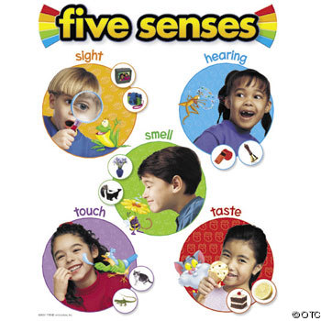
The Senses
Tactile (touch)
Olfactory (smell)
Visual (vision)
Gustatory (taste)
Auditory (sound)
Notes:
Experiential:
Vestibular – swivel chair and cushion
Prop – standing on one leg with eyes closed
Tactile – tactile toys
Olfactory – smelly putties, smellies
Taste – popcorn
Auditory – natural room noises
Proprioception (body position): The unconscious awareness of sensations from one’s joints, muscles, tendons and ligaments, the position sense. Proprioception describes a child’s ability to sense the position in space of limbs, fingers and other body parts. When integrated with other sensory input, proprioception is an essential component of coordinated movements such as grasping a utensil or catching a ball.
Vestibular Processing is the ability to interpret information relating to movement and balance. The vestibular system comprises a child’s ability to maintain balance and upright posture by sensing his/her own orientation with respect to gravity. As with proprioception, the vestibular system is directly involved in the execution and control of coordinated body movements, such as running and jumping.

Slide 8
The Hidden Senses
We have 2 hidden senses that respond to sensory input inside our body
Vestibular (gravity & movement)
Proprioceptive (muscles and joints)
Notes:
Vestibular – information about movement through the inner ear
Proprioceptive – information from muscles, ligaments and joints
We are not consciously aware of the hidden senses – we cannot control them and we cannot see them

Slide 9
Levels of alertness / the “Just Right” state
High or too alert
Just right
Low or not alert enough

Slide 10
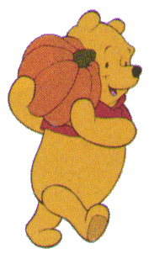
The “Just Right” State
Each of us go through varying levels of alertness on any given day.
We all use a combination of cognitive strategies and sensory activities to keep us feeling “just right” for most of the day.
We feel “just right” when we can interact well with others & we can participate in activities as we would like.
Notes:
Hand out Sensory Preference Checklist

Slide 11

The “Just Right” State
This is where we want children / adolescents to be.
When they are internally feeling “just right”, then their minds are alert and ready to learn.
They can sit in their seats and focus on what is being said to them.

Slide 12

Low or not alert enough
This stage describes how one might feel before having a cup of coffee /tea in the morning
or
Maybe how you feel when sitting in a dark,
warm room for a long meeting.

Slide 13

Low or not alert enough
How would a student present in the classroom?

Slide 14
This may look like…
Fidgeting, e.g. change position, tap leg
Play with hair, play with mouth
Chew pen / pencil
Talking
Looking around room / staring off into space
Day dreaming

Slide 15
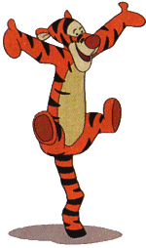
Too Alert
This level describes how you might feel when you have 5 people talking to you at once & you’ve had 3 cups of coffee.
You are not able to efficiently take in the information that’s being presented to you.
Notes:
Learning difficulties, speech & language difficulties & emotional state can all contribute to a young person becoming activated & which can transfer their body to a high regulation level.

Slide 16

Too Alert?
How would a student present in the classroom?

Slide 17
This may look like…
Poor attention in class
Difficulty getting along with peers
Described as “hyper”, “always on the go”, “chatter box”
Frequently interrupts teacher
Notes:
For example you might begin to breathe quick shallow breaths
Blood supply would decrease to the limbs and increase to the heart
Heart would start beating faster
Blood pressure and body temperature would rise

Slide 18
Protective Response
People who are sensitive to sensation may respond to ‘everyday’ situations/experiences with a protective response i.e.- flight, freeze, fight, vigilance, because their sensory system perceives it as threatening.
Notes:
It is important to remember that for some of the residents in the unit, they may have experienced or have been exposed to threatening situations prior to coming to the unit. Therefore their nervous system has become attuned to interpreting most situations as threathening and automatically become activated to respond to “everyday situations” in the same way - flight, freeze, fight, vigilance etc…
View world with a potential for danger
Experience of situations colours their perception of things and will go into fight / flight / fright state.

Slide 19
Which may look like
Flight- run! constant movement, avoidance of particular situations
Freeze- don’t move, quiet, withdrawn or express fear out of proportion to situation
Fight- confront the possible danger, irritable, aggressive, ‘heavy handed’
Vigilance- on alert: hearing over-sensitive, distractible, poor eye contact, fidgety

Slide 20
The sensory systems…
Each sensory system has sensations that usually alert the system and sensations that usually calm.
As a general rule sensations that are rhythmical, predictable and slow are calming
Sensations that are fast, arrhythmic and unpredictable are alerting.

Slide 21
Question??
Is it alerting or calming?
Taking a shower
Taking a bath
Being tickled
Getting a hug
Listening to loud music

Slide 22
In the classroom…
Inhibition
Top down inhibition
versus
Bottom up inhibition
Notes:
Cortex – thinking
Brain stem – contains reticular formation responsible in part for how alert we feel
Cerebellum – one of its jobs taking in information from muscles anad joints Mary school teacher can go out if have done work but engine in high gear tries use top down to

Slide 23

In the classroom…
Need to utilise bottom up inhibition through sensori-motor strategies

Slide 24
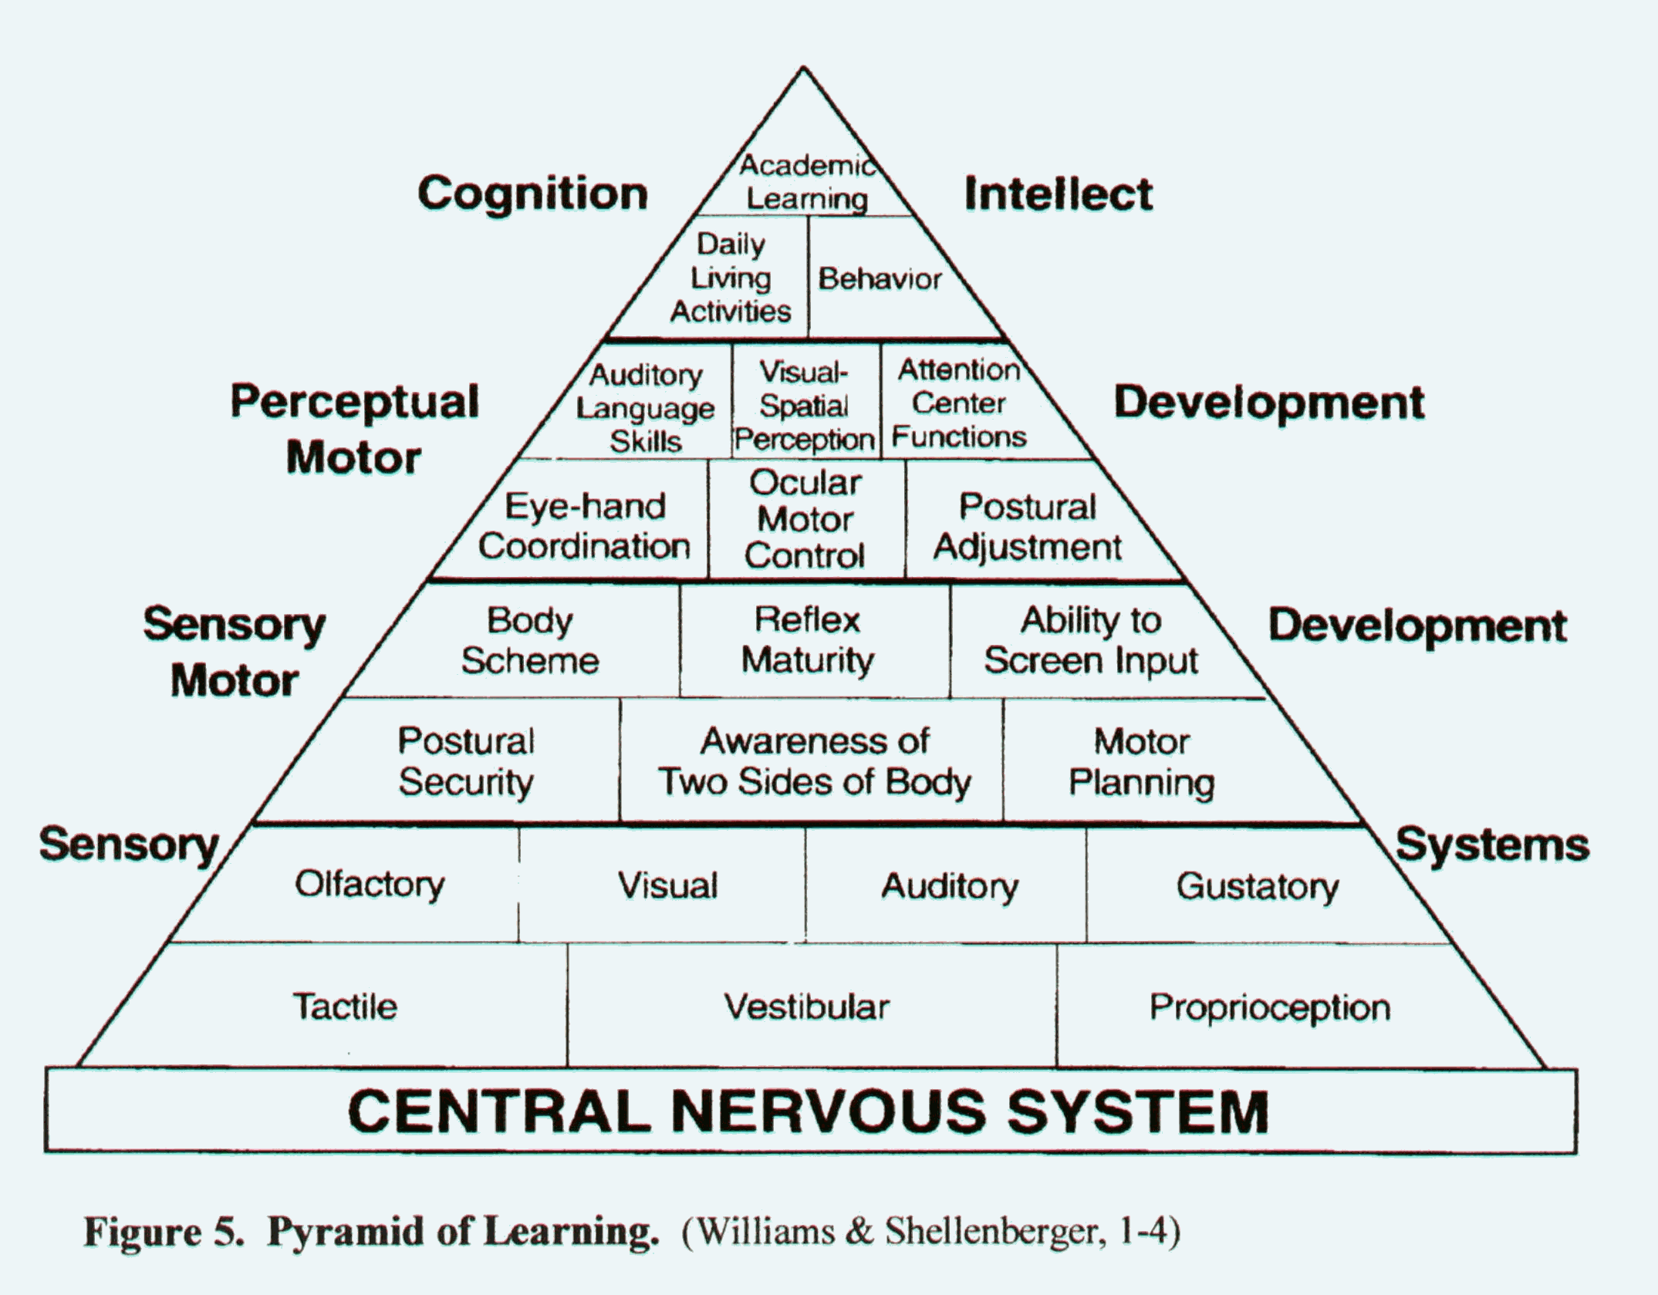
GOAL: Remain Regulated
Notes:
In the classroom:
– if their nervous system is well regulated, they will be in a better position to engage in higher order executive functional skills.
Brain is focusing on here and now and what to do for survival.
Brain has capacity to filter out what it doesn’t need. Problem for these kids is that they can’t switch off – become much more quickly aware of sensory stimuli around them.
In School:
Using movment input to help regulate and therefore aid concentration. E.g. Move and sit cushion, wall push ups, run an errand for the teacher = movement before the activity = regulated and attentive = completes taslk and able to go on the school trip.

Slide 25
Simple Strategies…
GOAL: REMAIN REGULATED.
Children / Adolescents
if their nervous system is in a “Just Right” state, they will be in a better position to maintain attention, engage discussion and complete school work.

Slide 26
Tools for the mouth
Food Items:
In general, foods that are alerting tend to be cold, sour/tart, spicy, minty, or crunchy
Foods that are calming tend to be warm, smooth, or sweet
Some foods fall under heavy work (for the jaw and cheek muscles) which can either calm or alert
Notes:
26
Tools for the Mouth
PASS OUT FOOD ITEMS IN BASKETS???
Tools for the mouth are a very useful sensory tool…and one that is often forgotten.
When we think about ourselves…many of the strategies we use even as adults involves sensory input to the mouth.
E.g. biting pens, chewing gum, leaning your chin on your hand.
Tools for the mouth include:
Food items
Non-food items.
Food Items:
In general, foods that are alerting tend to be cold, sour/tart, spicy, minty, or crunchy
Foods that are calming tend to be warm, smooth, or sweet
Some foods fall under heavy work (for the jaw and cheek muscles) which can either calm or alert
Examples of heavy work – Gum, water bottles, candy etc

Slide 27
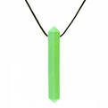


Tools for the mouth
Non Food Options:
Straws
Theratubing / krypto bite necklace
Chewy Tubes
ChewEase Pencil Top
Blow Pens
Whistles/Blow Toys
Blowing Cotton Balls
Notes:
27
Tools for the Mouth – Non food options
HAVE ITEMS ON DISPLAY
Here are some non food mouth tools…
Straws
Theratubing
Chewy Tubes
Humming
Blow Pens
Whistles/Blow Toys
Bubbles
Blowing Cotton Balls
Oral motor activity can be calming and organising or alerting depending on type.
Reinforce value of oral motor strategies. Water bottle in class, milkshake through straw in supermarket, chewy necklace.

Slide 28
Tools for the body (Ways to move)
Try different seating options:
Movin’ sit/disc ‘o’ sit cushion
A therapy ball
Allowing children to stand at their desks and work (often putting a piece of tape on the floor where they should stand/stay helps).
Notes:
28
Tools for the Body – Ways to Move
HAVE ITEMS ON DISPLAY
Movement is another sensory strategy that has a big effect on your attention/focus.
I would challenge the old belief…sit still and pay attention!
Movement whilst seated can be beneficial for some students…so it might be useful to consider different seating options. For example:
Try different seating options:
Movin’ sit/disc ‘o’ sit cushion
A therapy ball
A T-stool
Allowing children to stand at their desks and work (often putting a piece of tape on the floor where they should stand/stay helps).

Slide 29
Tools for the body
Up and down motions: Skipping, dunking a basketball, bouncing on a gym ball, pogo stick, lolo ball or marching
Front and back activities: Rocking in a chair, swinging, roller blading
Upside down activities: Hanging on bars, wheelbarrow walking, tumbles, head stands
Crash and bump activities: Jumping into piles of pillows or on an old mattress, driving bumper cars, pillow fights, playing football
Circles: Sit n’ spins, merry-go-round, spinning on a tire swing, riding on a ferris wheel
Notes:
29
Tools for the Body:
Different ways to move that can elicit different responses depending on the child. Front and back may be calming but then circles could become disorganised.
Up and down motions: Skipping, dunking a basketball, bouncing on a gym ball, pogo stick, lolo ball or marching
Front and back activities: Rocking in a chair, swinging, roller blading
Upside down activities: Hanging on bars, wheelbarrow walking, tumbles, head stands
Crash and bump activities: Jumping into piles of pillows or on an old mattress, driving bumper cars, pillow fights, playing football
Circles: Sit n’ spins, merry-go-round, spinning on a tire swing, riding on a ferris wheel, spinning in an office chair

Slide 30
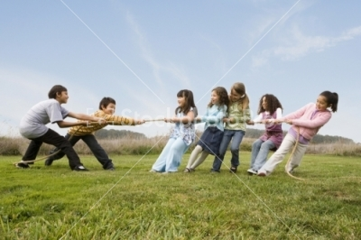
Heavy Work
Heavy work is the
performance of tasks that
involve heavy resistance
and input to the muscles
and joints:
- pushing
- pulling
- lifting
- carrying
- moving heavy items
- stretching
Notes:
30
Tools for the Body – Heavy Work
Heavy work is another important sensory tool – and we will talk about it quite a bit.
Heavy work is the performance of tasks that involve heavy resistance and input to the muscles and joints:
- pushing, pulling, lifting, carrying, moving heavy items, stretching .
Heavy work can have both calming and alerting effects so it can be used when engines are either too high or too low. Its rarely overloading to the nervous system. So it is a very useful sensory tool!
Note: All of these sensory strategies are bootm up inhibition tools…

Slide 31

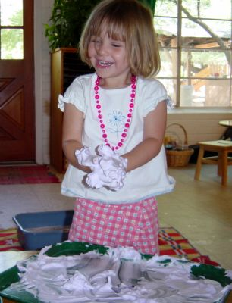
Tools for the hands (Touch)
Weighted blanket/snake
Lap weights
Hand fidgets - therapy putty, string, paperclips, stress balls, koosh balls
Rice/sand play
Finger paints
Funny foam
Hand cream/moisturiser
Notes:
31
Tools for the hands (touch)
HAVE ITEMS ON DISPLAY
Touch is another sensory strategy that we will experiment with during the group.
Here is a list of some of the tactile tools:
Weighted blanket/snake, Lap weights, Bear hug, Chair hugs, Body sox, Rice/sand play, Finger paints, Funny foam, Hand cream/moisturiser.
Hand fidgets are another valuable sensory strategy e.g. - therapy putty, string, paperclips, stress balls, koosh balls
Note on fidgets- it’s important for teachers especially to remember that these items, when used correctly can help kids focus better rather than distract them. The teacher needs to recognize that it is possible and even preferable for some student to listen to a lecture while keeping their hands busy- a student doesn’t have to be looking at the teacher to be listening. The “How is your Engine running” book talks more about how to introduce and use fidgets at home and in the classroom.
PASS OUT FIDGETS

Slide 32

Tools for the eyes
Try dimming the lights and closing the blinds to calm
Muted colours and plain walls tend to be calming
Bright colours, “busy” walls, bright lights and art work tend to be alerting or distracting

Slide 33
Tools for the eyes
Tips to reduce distractions:
Secure art work, maps and graphics on the wall so that they don’t flutter
Tack a sheet over open shelves to cover art materials/games/toys etc…
Remove mobiles swinging from light fixtures
Adjust window blinds to prevent light from flickering through
Consider positioning of the student in the classroom setting
Provide low distraction area e.g. a study booth
Cardboard template
Notes:
Tips to reduce distractions:
Secure art work, maps and graphics on the wall so that they don’t flutter
Tack a sheet over open shelves to cover art materials/games/toys etc
Remove mobiles swinging from light fixtures
Adjust window blinds to prevent light from flickering through
Consider positioning of the student in the classroom setting. The movement of other children may also be visually distracting, have the child sit near you at the front f the room with his back to the rest of the room (or at the edge of a table). Surround the child with other students that sit quietly, pay attention and serve as good role models.
Provide low distraction area e.g. a study boothe
Cardboard template
Some students are very sensitive to fluorescent lights- be aware of how kids react in response to light

Slide 34
Tools for the ears
Sounds that are short, arrhythmic, loud, or novel tend to be alerting
Sounds that are rhythmical, quiet, long in duration, and familiar are calming and easier to ignore
Try using music of various types and volumes to change alertness levels
Create “cozy corners” where students can be when the noise is overwhelming
Notes:
34
Tools for the ears:
Auditory information can have a big impact on our focus/attention. Thinking about auditory strategies…
Sounds that are short, arrhythmic, loud, or novel tend to be alerting
Sounds that are rhythmical, quiet, long in duration, and familiar are calming and easier to ignore
Try using music of various types and volumes to change alertness levels
Create “cozy corners” where kids can be when the noise is overwhelming
For kids who are sensitive to noise, let them use earplugs or headphones in the cafeteria or assemblies
During tests let kids wear headphones (with no sound) to help block out distractions
Think about your own ideal study situation…who likes background music vs who needs a quiet setting without noises?

Slide 35
Tools for the ears
For students who are sensitive to noise, let them use earplugs or headphones in the cafeteria or assemblies
During tests let students wear headphones (with no sound) /earplugs to help block out distractions
Tennis balls on bottom of chairs
Position student away from loud noises (e.g. window, air conditioning)

Slide 36
“Just Right Environment”
What changes can you make to your classroom

Slide 37
Reference Information
Check out the Alert Program website: www.alertprogram.com
Ayer,A.J. (1979). Sensory integration and the child. Los Angeles: Western Psychological Services.
Williams, M.S. & Shellenberger, S. (1994). “How does your engine run?” A leader’s guide to the Alert Program for self-regulation. Albuquerque, NM: TherapyWorks, Inc.
Williams, M.S. & Shellenberger, S. (2001). Take 5! staying alert at home and school. Albuquerque, NM: TherapyWorks, Inc.
Drive Thru Menus – Calming and Stress Busting Kit by Tere Bowen-Irish www.therapro.com
Notes:
Also see resources handout that the OT department put together on a range of different areas/skills, including sensory processing…

