Slide 1



Supporting Parents to support their Children’s Mental Health and Wellbeing .
20th June 2018
Notes:
Deirdre

Slide 2

Background
NPC anti-bullying training for parents:
Resilience
Self-esteem
Friends
Parent/child relationships
Empowerment

Slide 3
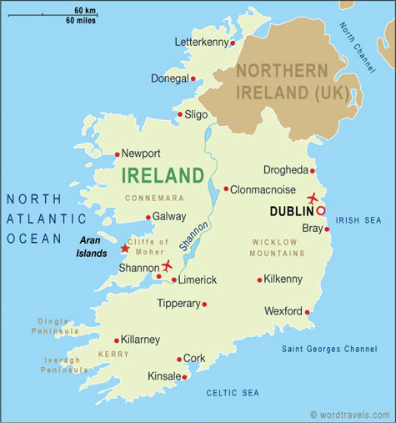



How Training works

Slide 4
Aim of the Session
An understanding of the factors that influence children's mental health and well being
How to build and nurture children's resilience
Practical tips on how best to support children’s mental health and wellbeing.

Slide 5
How many parents have we reached?
Year | No. of sessions | Total no. of attendees
2015 (not a full year) | 65 | 1720
2016 | 85 | 2331
2017 | 99 | 2372
Totals | 249 | 6423 (including 274 teachers)

Slide 6

95% increase confidence supporting their child’s mental health
93.3% of the participants found the ‘Supporting Parents to Support their Children’s Mental Health and Wellbeing’ to be either ‘very good’ or ‘excellent’
98% would recommend the course to others

Slide 7

Key Points!
Partnership works
Early Prevention
Parents want support
Parents value this session
This Photo by Unknown Author is licensed under CC BY-NC-SA

Slide 8

alynch@npc.ie

