Slide 1
3rd International
Self Harm Awareness Conference 2018
Better Support through Better Self-Care
Facilitated by Pauline Bergin, Pieta House
EMAIL: mary@pieta.ie
PHONE: 01-601 0000
WEB: www.pieta.ie

Slide 2
OUR VISION:
A world where suicide, self-harm and stigma have been replaced by hope, self-care and acceptance.

Slide 3
OUR MISSION:
We support people and communities in crisis by providing freely accessible, professional services to all.
OUR VALUES:
We treat everyone with respect and dignity
We are rooted in compassion and care
We generate and nourish hope
We empower

Slide 5
Help Others by Helping Yourself
You will hear a lot today about how to support students and co-workers with their issues.
But one of the most effective ways that you can care for others is by caring for yourself.
By caring for yourself, you are better placed to be able to help the needs of others.

Slide 6
Self-Care
Self-care is about actively looking after your own mental health and wellbeing so that you can more effectively support the people you work with.
Notes:
I would also mention any boundaries that you have, eg times you are available

Slide 7
Self-Care
The concept of self-care is similar to the safety procedures on an aircraft:
“In the unlikely event of an emergency, fit your own oxygen mask first, before attending to children or dependents”
By putting yourself first, you can more effectively help your those in need.

Slide 8
How to Self-Care
How do you manage stress?
How do you protect yourself when you are faced in situations where you witness people struggling and animals not being cared for. Or when you witness an accident?
Are you looking after your diet, taking regular exercise, getting enough sleep? These are essential to our physical and emotional wellbeing.
How do you nurture yourself, or do you?
Being able to talk about your stresses in supportive relationships.

Slide 9
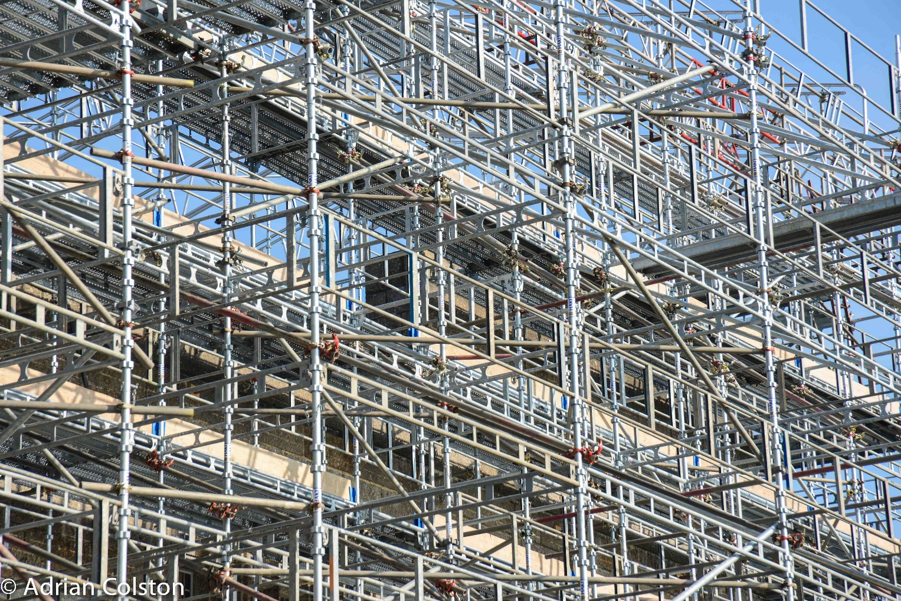
When we think of support – Lets look at SCAFFOLDING OF SELF
Strong support – supporting yourself when the foundation maybe be feeling broken or smashed.
To underpin and structure
The work is to repair and maintain
Rooted in COMPASSION AND CARE for self…….

Slide 10
Self-Care
Self-Harm
FRIENDS | FAMILY | RELATIONSHIP
WORK | SPIRITUALITY | HOBBY
GIVING BACK | SELF IMPROVEMENT | HEALTH
9 Boxes
Who supports you
Peer Support
Diet/Exercise/Rest
Exercise Can lift a mood
Schedule Fun in your life
Self-Awareness
Are you aware you are carrying stress
Laughter is the best medicine

Slide 11
Practical Ways to look after your Mental Health
Keep active
Talk about your feelings
Eat well
Take a break
Keep in touch with friends and family
Accept who you are
Drink sensibly
Care for others
Do something you’re good at
Ask for help

Slide 12
The BEST 6 Doctors
Sunshine
Water
Rest
Air
Exercise
Healthy Eating

Slide 13
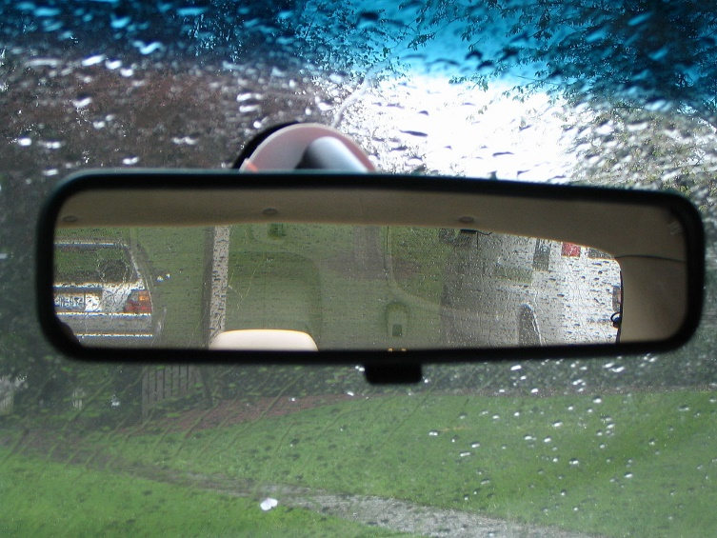
Rear View Mirror

Slide 14
Smile Often
Think Positively
Give Thanks
Laugh Loudly
Love Others
Dream Big

Slide 15
GUIDED MEDITATION
If you Struggle just “be” with what is...We can no longer be strangers to our hearts
The practice of mindfulness give us a way to befriend our emotions.
Giving a living and a breath to our emotions with acceptance.
Allowing room to breathe and healing
Embracing the pain in mindfulness and it will be transformed.
Notice the transformation of giving time to the self, and how it can be healing
To the soul, settling into what needs be.

Slide 16
Mindfulness Led mediation ( 15 minutes)
I invite you now to slow down in everything and give this time to yourself.
Note your posture and adjust to be comfortable in a sitting position.
We will first address settling into “stopping”. If you don’t stop you don’t rest
Might I ask you to just allow your body to let go in this moment to relaxation. Allow your eyes to close or soft focus.
Give yourself a few moments to “let Go in your body”.
Now we can give the attention to our breath. Just observe your breath
And the rise and fall of your breath. Breathing in, breathing out, each
Following without gesture or deliberate action. Notice this..... be with this
Breath....without change or hurry or critic. You can come home to your breath
As you breathe, notice the slight air on your nostril as you breathe out and in
Also notice that slight but definite pause between breath in and out
Now Im going to ask you to take a big deep breath in through the nose
And out through the mouth. Deliberate and clear.
In with Positive and out with Negative. Do this a few times and return to normal
Breath, you might notice a slight change in how relaxed you are.
I invite you to again check in on letting go and allow your body to slip more
Into the seat and remembering the word “ Let Go”

Slide 17
I ask that you give permission now to give some time to you and space to relax
And be present to what you might need right now.
Taming the Mind. Your mind may wander and without judgement, notice kindly where your
Mind goes, see the thoughts that draw your attention and let go gently
Escort your attention back to your breath. REPEAT
To the present. Allow time to settle, for the mind to come to rest. Listen to the sounds you can hear right now, allowing the sounds to pass you by and allowing you to focus inward. Notice your attention and this may prove difficult to let go to relaxation. The practice of resting and stopping is essential to knowing the self. Breathing in I am aware of my thoughts, I smile to my worries.
Breathing in I notice how I can become distracted.
Time now to settle until you are comfortable allowing your body to let go
To relaxation. You are safe and we are together in this experience.
I am giving this space to myself in this wonderful space for me.
Become aware of the space you are right now. Imagine yourself as a mountain
Strong stable and still. Is this where I am now safe to stop.
I choose to be gentle to me. Enjoy the slowing down an through the breath, use as a resource
To calm and still the mind body spirit = A resting place!!!!
Your escape, your private place.

Slide 18
Breath work exercise
7 – 11 breath exercise placing your hands on your tummy.
Allow your breath, as a tool to calm you and settle you – Breathing in through the nose for a count of 7, hold for a moment and breathing out through the nose slowly for as long as you can do this.
Lab exercise: Light, people, machinery. (imagine yourself walking into your brain and seeing three switches with Light, People, Machinery)
Noticing the noise of these three components and slowly and deliberately turn off each switch one by one and NOTICE the difference. When all switches have been released, walk back out of your life)
If we connect, we can work with and towards not against.
I wish to calm my mind, I want to hold my body in awareness
Embracing each part of your body, like a mother to her child, with loving
Kindness.
Now be with your body, what is it telling you. How can you gently
Meet your thoughts,To know how you are....go gently and kindly.
This is my safe place, this is where I sit.
As we remain still and present, notice what is asking for your attention and
Our minds will take us to where we need to be.

Slide 19
May I be filled with loving-kindness May I be well May I be peaceful and at ease May I be happy
Grounded exercise
And now as we begin to return to the room and our lives in living.
I invite you to check in with your body start moving and become aware that you are back to the now
I invite you to check in with your spirit and hold kindness
I invite you to check in with your mind and check you are ready and able to return to this space.
On the count of 10 Im going to ask you to come back to the room, moving your hands and feet and finding a firm place to come back to. Move your body any way you which to ensure you are safe to continue your day.
10…..9….. Moving your toes, feet and hands…. 8…..7….6 moving your body adjusting your posture….5…..4… opening your eyes….3…2…1..
Fully awake and present.
I ask you remember the lab exercise and use it whenever you might need.
Thank you for the piece of work we shared today and go gently for the remainder
Of the day in kindness to yourself.
Please remember if anyone feels overwhelmed or unsteady, please take care and you can pop up to me later.

Slide 20
I hope you never loose your sense of wonder.
You get your fill to eat but always keep that hunger.
May you never take one single breath for granted?
God forbid love ever leave you empty handed.
I hope you still feel small when you stand beside the ocean.
Whenever one door closes, I hope one more opens.
Promise me that you’ll give faith a fighting chance
And when you get the chance to sit
out or dance
I Hope you dance, I hope you dance.

