Slide 1
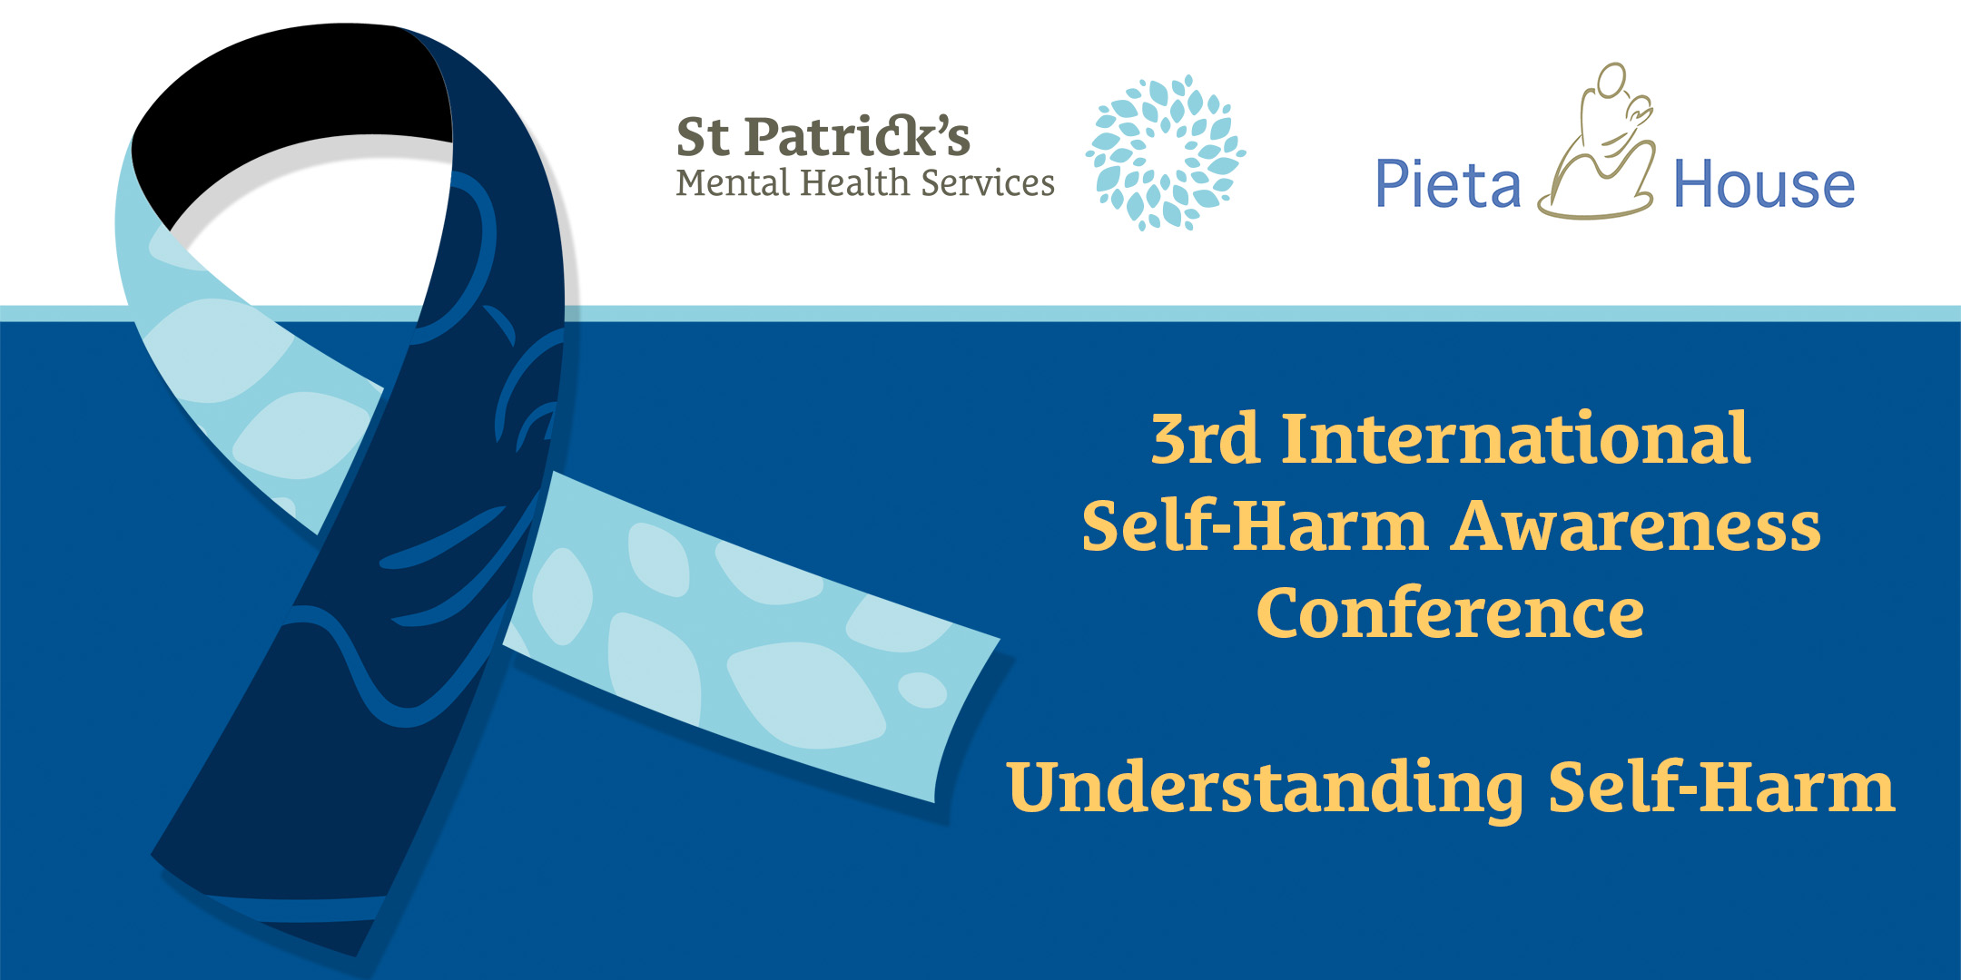
Moving Adolescents from
Self-Harm to Self-Care
Facilitated by Marguerite Kiely, Pieta House
EMAIL: mary@pieta.ie
PHONE: 01-601 0000
WEB: www.pieta.ie

Slide 2
OUR VISION:
A world where suicide, self-harm and stigma have been replaced by hope, self-care and acceptance.

Slide 3
OUR MISSION:
We support people and communities in crisis by providing freely accessible, professional services to all.
OUR VALUES:
We treat everyone with respect and dignity
We are rooted in compassion and care
We generate and nourish hope
We empower

Slide 4
OUR SERVICE
The service was founded by Psychologist Joan Freeman and Pieta House opened its doors in January 2006.
Our client base is specifically targeted at people who are experiencing suicidal ideation, people who have attempted to take their lives and people who are engaging in deliberate self-harm.
We provide one-to-one therapy where the foundation is rooted in compassion and care.

Slide 6
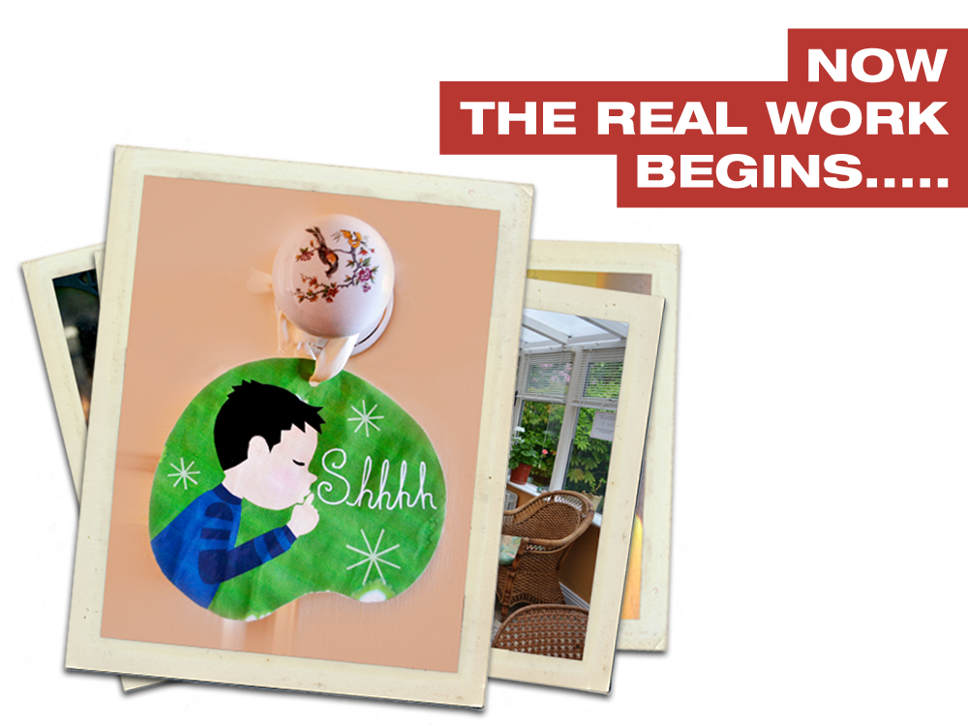

Slide 7
Notes:
All our Therapists are professionally qualified and accredited and the team is made up of both Psychotherapists and Counselling Psychologists.
Staff are carefully selected and are chosen not alone for their academic qualifications but also for their personal warmth.
The Therapists are trained in the therapeutic models developed by Pieta, where we aim to lift suicidal ideation and in relation to self harm, we aim to move the client from self harm to self care.

Slide 8
DEFINITION OF SELF-HARM:
“The commission of deliberate harm to one's own body. The injury is done to oneself, without the aid of another person, and the injury is severe enough for tissue damage (such as scarring) to result”
Source: Winchel and Stanley (1991) American Journal of Psychiatry
OPH 2.1

Slide 9
What feelings do
Self-Harm bring up
for you?

Slide 10
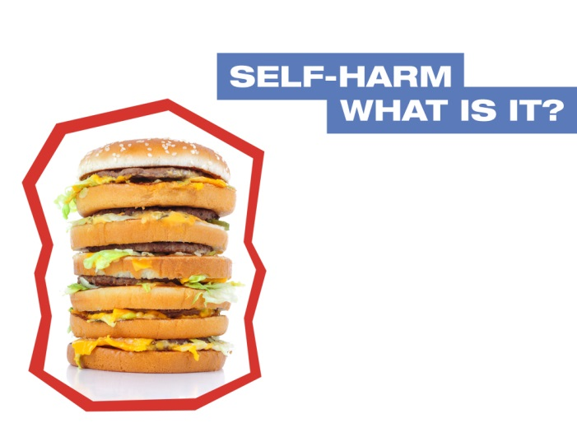
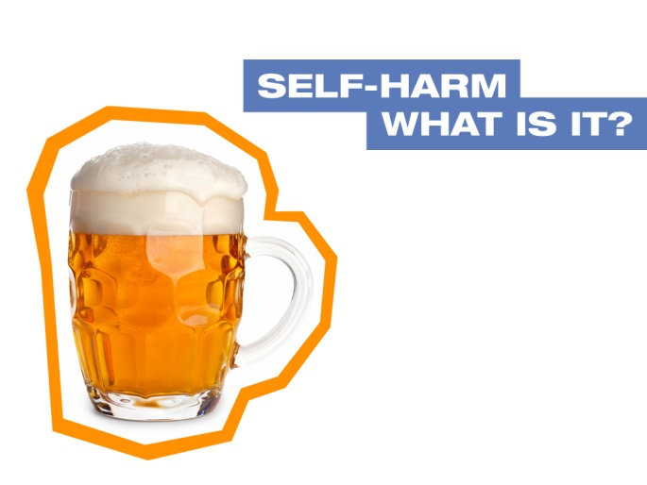
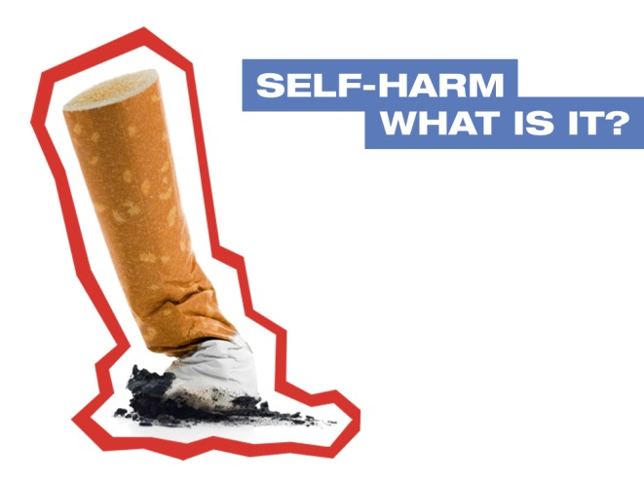
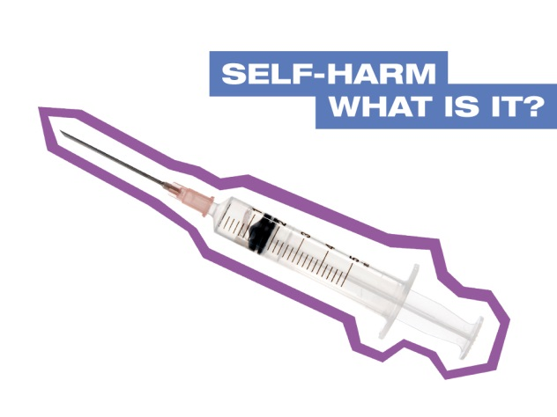
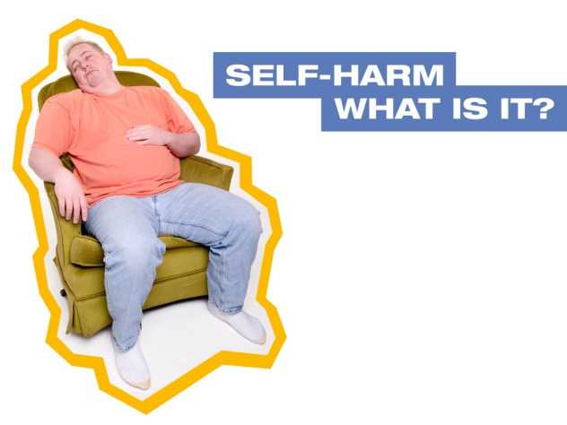
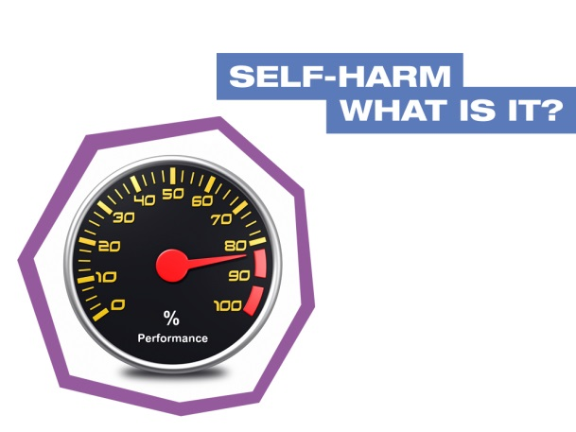
SELF-HARMING BEHAVIOURS
OPH 4.2

Slide 11
SELF-HARMING BEHAVIOURS
CUTTING
SCRATCHING/PICKING
BURNING
FACE PUNCHING
INGESTING OBJECTS
WALL BANGING
INSERTING OBJECTS
OVERDOSING
FALLING DOWN STAIRS
BREAKING BONES
DRINKING BLEACH
EYEBROW / EYELASH /HEAD HAIR PULLING (Trichotillomania)

Slide 12
Myths and Facts for Self -harm
Myth: Self-harm is attention seeking
Fact: Most Self-harm takes place in private.
Myth: Self-harm is a suicide attempt
Fact: Most people who engage in Self-harm do so as a way of staying alive (coping) it’s not about ending (suicide)
Myth: People who engage in Self-harm enjoy pain
Fact: People who engage in self-harm do so to shift the focus from the emotional distress, and are possibly trying to communicate that distress.

Slide 13
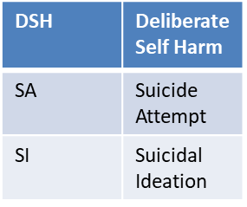
Statistics for 2017
Age Range | DSH Only | SA and DSH | SI, SA and DSH | SI and DSH | Grand Total
Under 18 Years | 244 | 5 | 292 | 650 | 1,191
18 – 24 Years | 55 | 9 | 332 | 363 | 759
25 – 44 Years | 33 | 13 | 250 | 201 | 497
45 – 64 Years | 16 | 3 | 63 | 53 | 135
65 Years or Over | 0 | 0 | 3 | 3 | 6
Grand Total | 348 | 30 | 940 | 1,270 | 2,588

Slide 14
WHY DO PEOPLE SELF-HARM?
Coping with feelings
Relieving guilt and self-hatred
Communication
Control
Feeling ‘real’ and alive

Slide 15
The Appropriate Language to use in relation to Self-harm
Never refer to a person as a Self-harmer
Never refer to someone as a “Head-banger”, if that’s the form of harm they engage in.
In Ireland self-harm is referred to as “Deliberate Self-harm”.
Other terms are: Self-Injury, Self-inflicted violence, non-suicidal self injury and (a very old term), Self-mutilation.
At Pieta we simply use the term “self-harm”.
Never label a person by their behaviour.

Slide 16
Working with Young People in the ‘Pieta Way’
ASSESSMENT PROTOCALL
All children and adolescents attending Pieta must be accompanied by the main carer i.e. A parent, social worker or legal guardian.
The purpose of the assessment is to gather background information, risk assess and to determine if our model of therapy will meet the needs of the child i.e. they’re engaging in self harm or struggling with suicide ideation.
Parents sign confidentiality agreement and parental consent form. Parents are seen first then the child – adolescent is seen separately. Parents are always informed of risk level at assessment.

Slide 17
Working with Young People in the ‘Pieta Way’
Therapy Protocol – The focus of the therapy is to lift suicide ideation and replace self-harm coping mechanism with healthy alternative coping strategies.
Session format – 15 sessions of 50 minutes duration. Parents must be met for the first 5 minutes and again at the end of each session / unless there is conflict with the child, the needs of the child come first.

Slide 18
Working with Young People in the ‘Pieta Way’
Inter agencies – If a child is referred from school a standard letter is forwarded acknowledging the child has attended. It is recommended there is a liaising with any other agency the child is attending.

Slide 19
Issues Young People Present With
Depression
Suicidal Ideation
Childhood Trauma
Anxiety
Eating Disorders
Bullying / Cyberbullying
Family Difficulties
Stress
Sexuality and identity
Self-harming behaviours
Relationship difficulties
Low Self-Esteem
Peer Pressure
Social Media

Slide 20
Responding to Young Peoples Needs
Listen
Ask open-ended questions
Take what they are saying seriously
Enlist additional support if required
Stay Calm
Stay with the person if their safety is in jeopardy
Empathise

Slide 21
Responding to Young People in Distress
Include adolescents in discussions about a variety of topics, issues, and current events
Encourage adolescents to share ideas and thoughts with you
Encourage adolescents to think independently and develop their own ideas
Assist adolescents in setting their own goals

Slide 22
Responding to Young People in Distress
Stimulate adolescents to think about possibilities of the future
Compliment and praise adolescents for well thought out decisions
Assist adolescents in re-evaluating poorly made decisions for themselves

Slide 23
Helpful Resources Available to Young People
VISUALISATION TECHNIQUES
MINDFULLNESS
FRIENDS
MUSIC
SPORTS
ONE GOOD ADULT
EXERCISE
FAMILY
CREATIVE WRITING
PLAY
ART
TALKING

Slide 24
Helpful Resources Available to Carers
BeLonG To
www.belongto.org
Barnardos
www.barnardos.ie
Pieta House
1800 247 247
BodyWhys
1890 200 444
Webwise www.webwise.ie
AsIAm
www.AsIAm.ie
Reach Out
https://ie.reachout.com/

Slide 25
SELF-CARE
Self-care is about actively looking after your own mental health and wellbeing so that you can more effectively support the people you work with.
Notes:
I would also mention any boundaries that you have, eg times you are available

Slide 26
SELF-CARE
The concept of self-care is similar to the safety procedures on an aircraft:
“In the unlikely event of an emergency, fit your own oxygen mask first, before attending to children or dependents”
By putting yourself first, you can more effectively help your those in need.

Slide 27
How to Self-Care
How do you manage stress?
How do you protect yourself when you are faced in situations where you witness people struggling and animals not being cared for?
Are you looking after your diet, taking regular exercise, getting enough sleep? These are essential to our physical and emotional wellbeing.
How do you nurture yourself, or do you?
Being able to talk about your stresses in supportive relationships.

Slide 28
THE 9 BOXES
FRIENDS | FAMILY | RELATIONSHIP
WORK | SPIRITUALITY | HOBBY
GIVING BACK | SELF IMPROVEMENT | HEALTH

Slide 29
SELF-CARE
9 Boxes
Schedule Fun in your life
Peer Support
Diet/Exercise/Rest
Self Awareness

Slide 30
A MESSAGE OF HOPE…
We all struggle in life from time to time but with the right support we can get through it…
A sense of love and belonging makes it easier for us to stay in the world…
REMEMBER: Knowledge is power and knowing what to look out for may save the life of someone you know

Slide 31
Thank you for supporting the work of Pieta House and our Clients.
Messages from our Clients:
‘I am not just existing anymore, I am living’
‘Pieta House saved my life. The may sound dramatic but it’s true’
‘Thank you for your support for my daughter when she needed it’
‘Thanks for being there when needed’
‘Thank you for shining your light in such a dark place’

